Slide 1
CSCE 5290 NATURAL LANGUAGE PROCESSING FINAL PROJECT
Unlocking Business Insights: Sentiment Analysis of Summarized user reviews
Group | 11
Name | ID
Sijo Rejigeorge | 11708233
Kishan Kumar Zalavadia | 11685261

Slide 2
INTRODUCTION
Nowadays, the ease of expressing opinions and views via internet has enabled consumers to share their experiences much more widely. The vast amount of textual data posted over the internet as feedback can be overwhelming for an individual or a business to consume. These reviews are vital informations that can help business to take informed choices to improve the product or services and also to meets with the standards expected from the customers. But the large number of reviews can be the hindrance between making informed decision that provides a better service or one that is mediocre.
Hence there's a need for an automated tool that can summarize the reviews while also providing an overall sentiment towards the same. This project explores the possibility of text summarization of online business reviews along with sentiments that can help business get an overall idea about customer satisfaction.

Slide 3
PROBLEM STATEMENT/HYPOTHESIS
Online reviews servers as a basis of considering whether a product or service is worth buying or using. Reviews also plays a vital role in helping business understand where they needs to improve the service or what area of the business are customers loving. But the enormous scale of reviews that can be posted by consumers in this modern era can make it quite impossible for business to go through them efficiently.
Developing a text summarization tool for online reviews that can concise the entire reviews into few relevant lines while also preserving the different opinions and sentiments of the reviews can help business to navigate through vast amount of data more effectively.

Slide 4
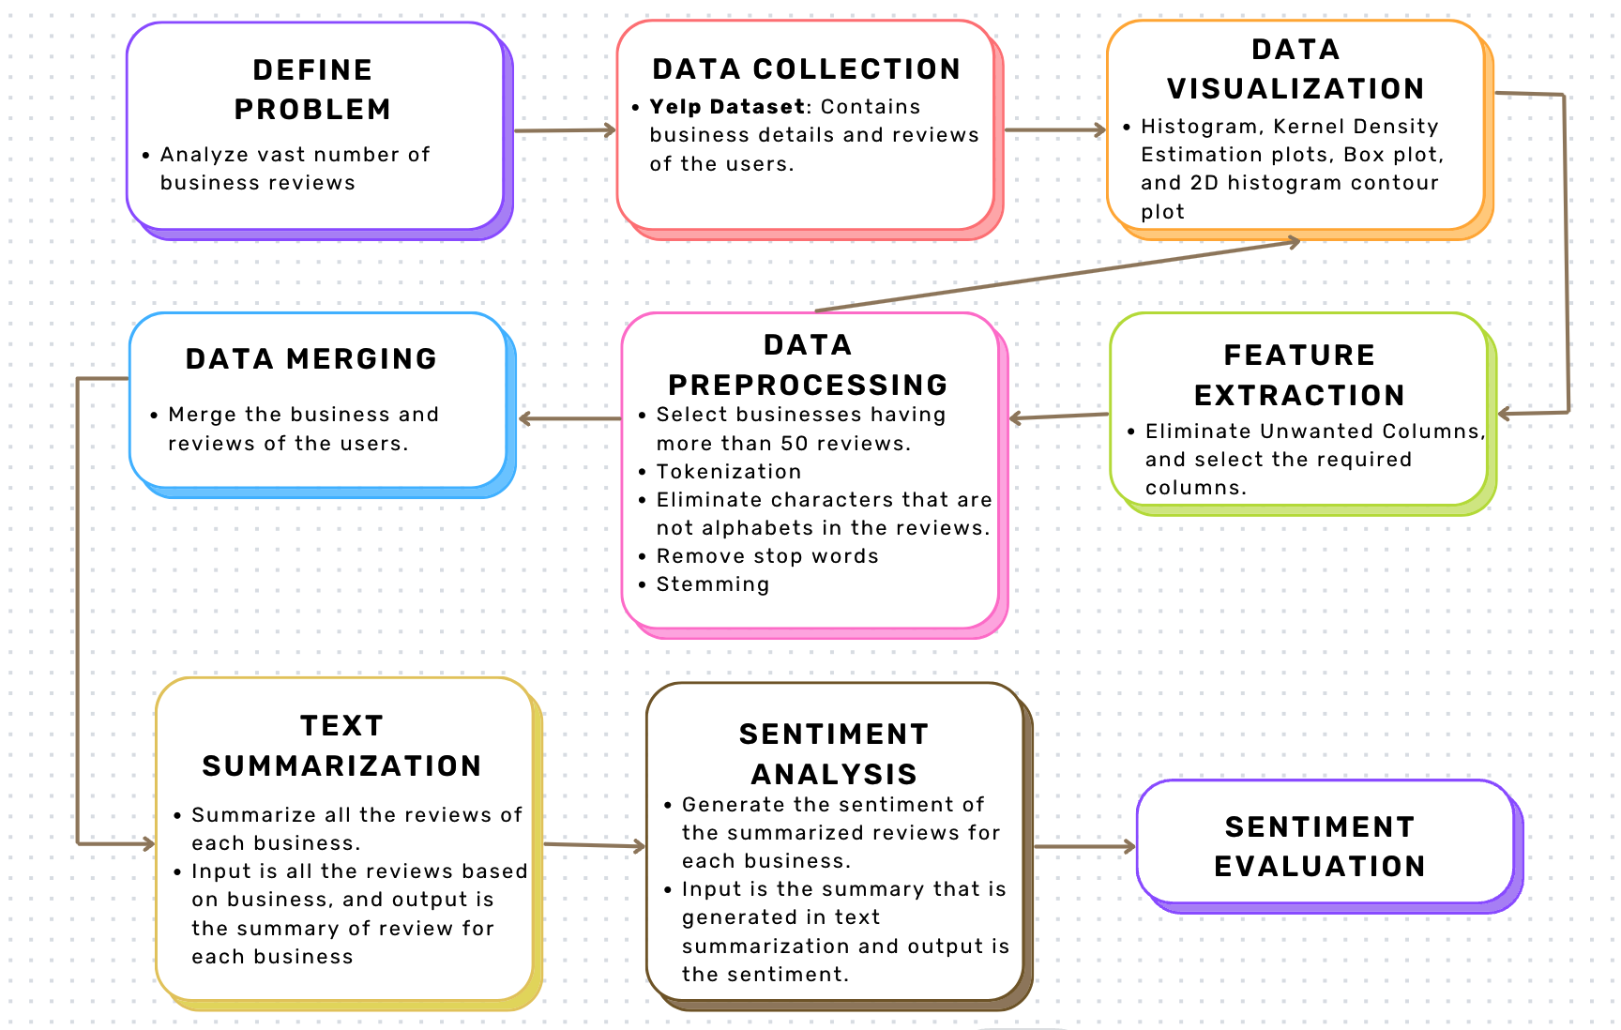
MODEL/METHODOLOGY OVERALL WORKFLOW DIAGRAM

Slide 5
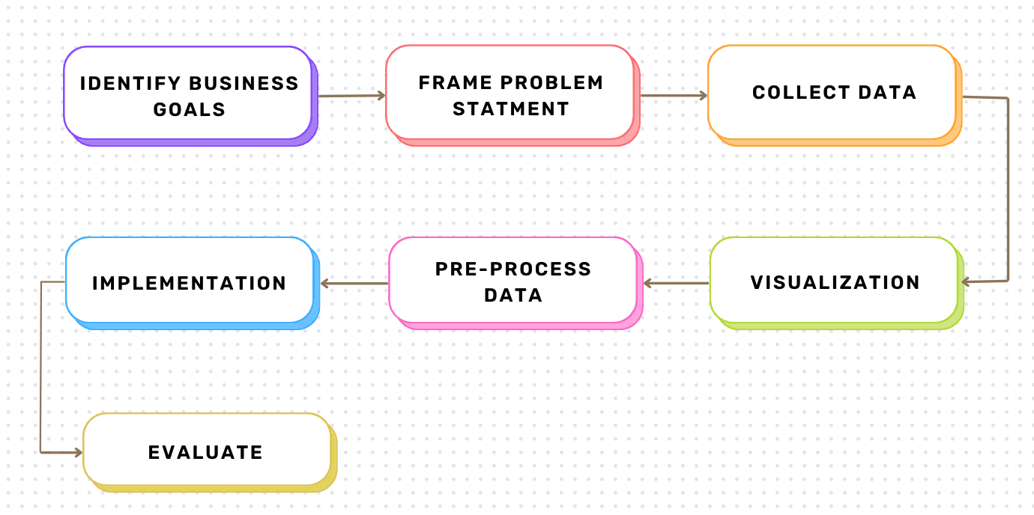
MODEL/METHODOLOGY
ARCHITECTURE DIAGRAM

Slide 6
Dataset
Description/Representation of Dataset

Slide 7
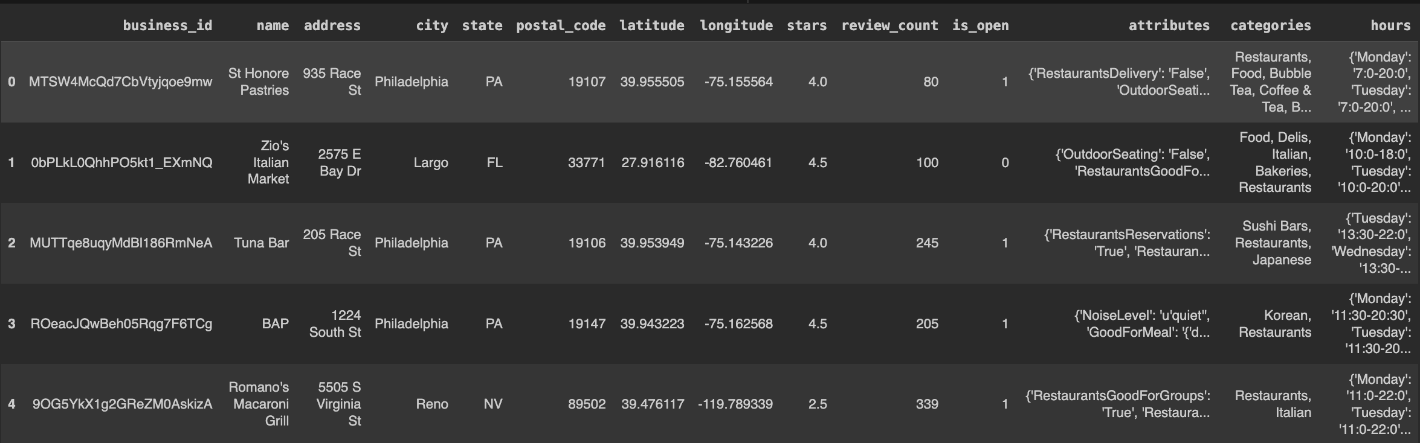
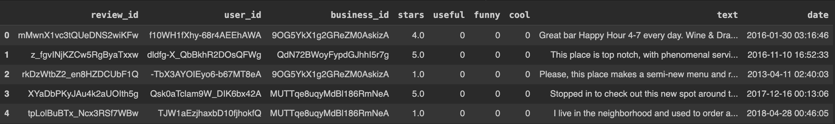
Dataset –1: Business Dataset
Dataset – 2: Review Dataset

Slide 8
Dataset
Design of Features/ labels

Slide 9
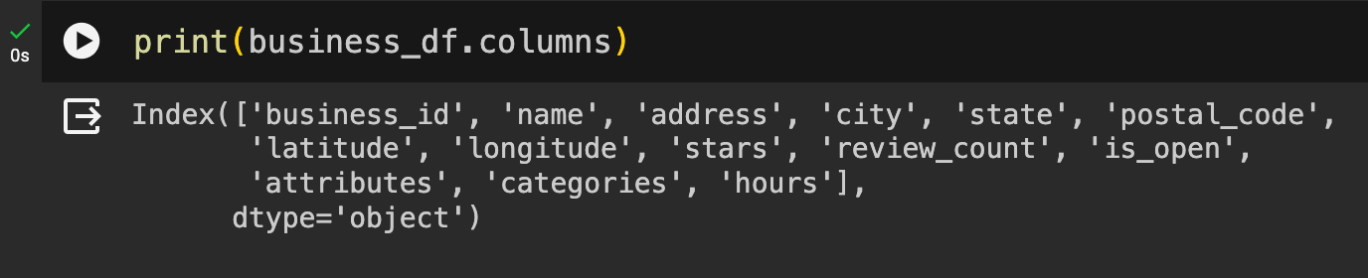
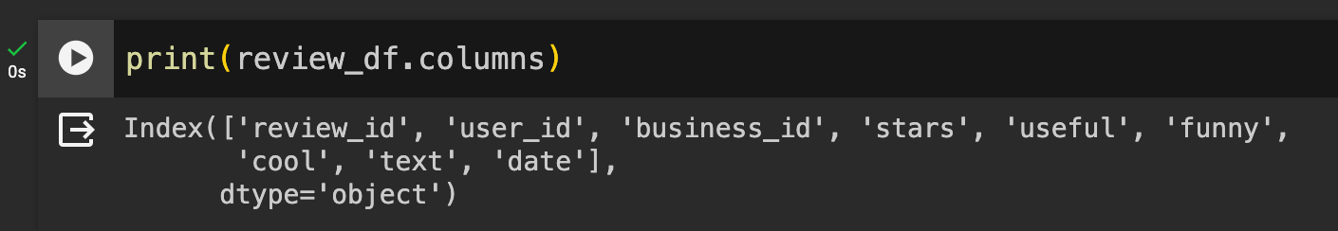
Features:
Dataset –1: Business Dataset
Dataset – 2: Review Dataset

Slide 10
Exploratory Data Analysis
Data Visualization
before pre-processing

Slide 11
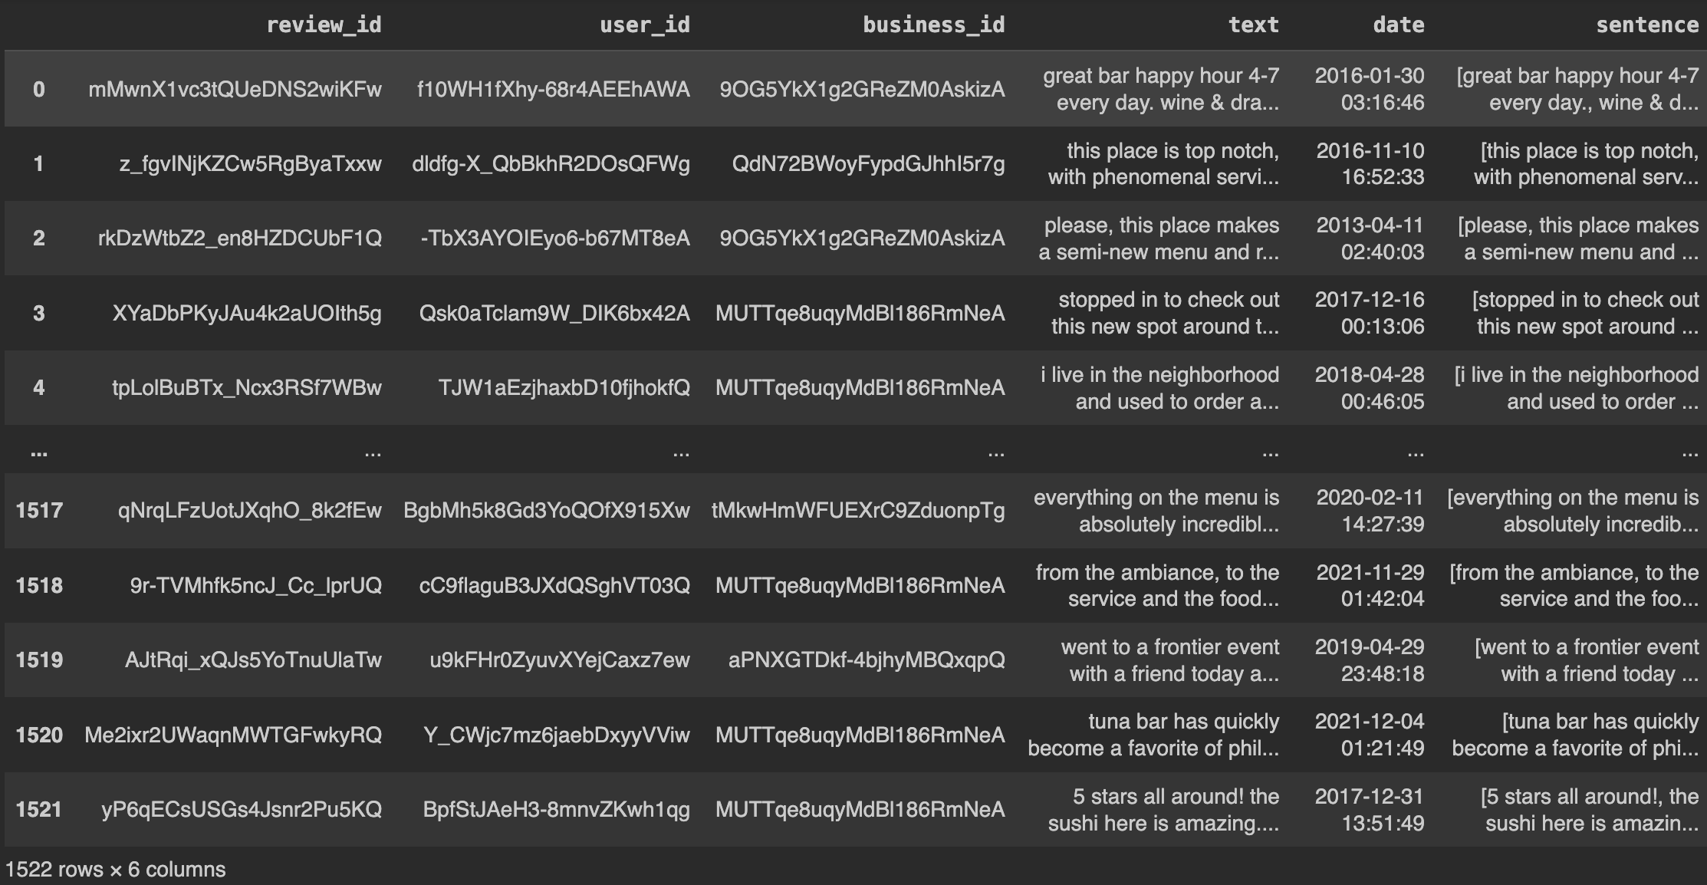
1. Sentence Tokenization
Each sentence is considered as a token.
Sentence tokenization is done using the NLTK library.

Slide 12
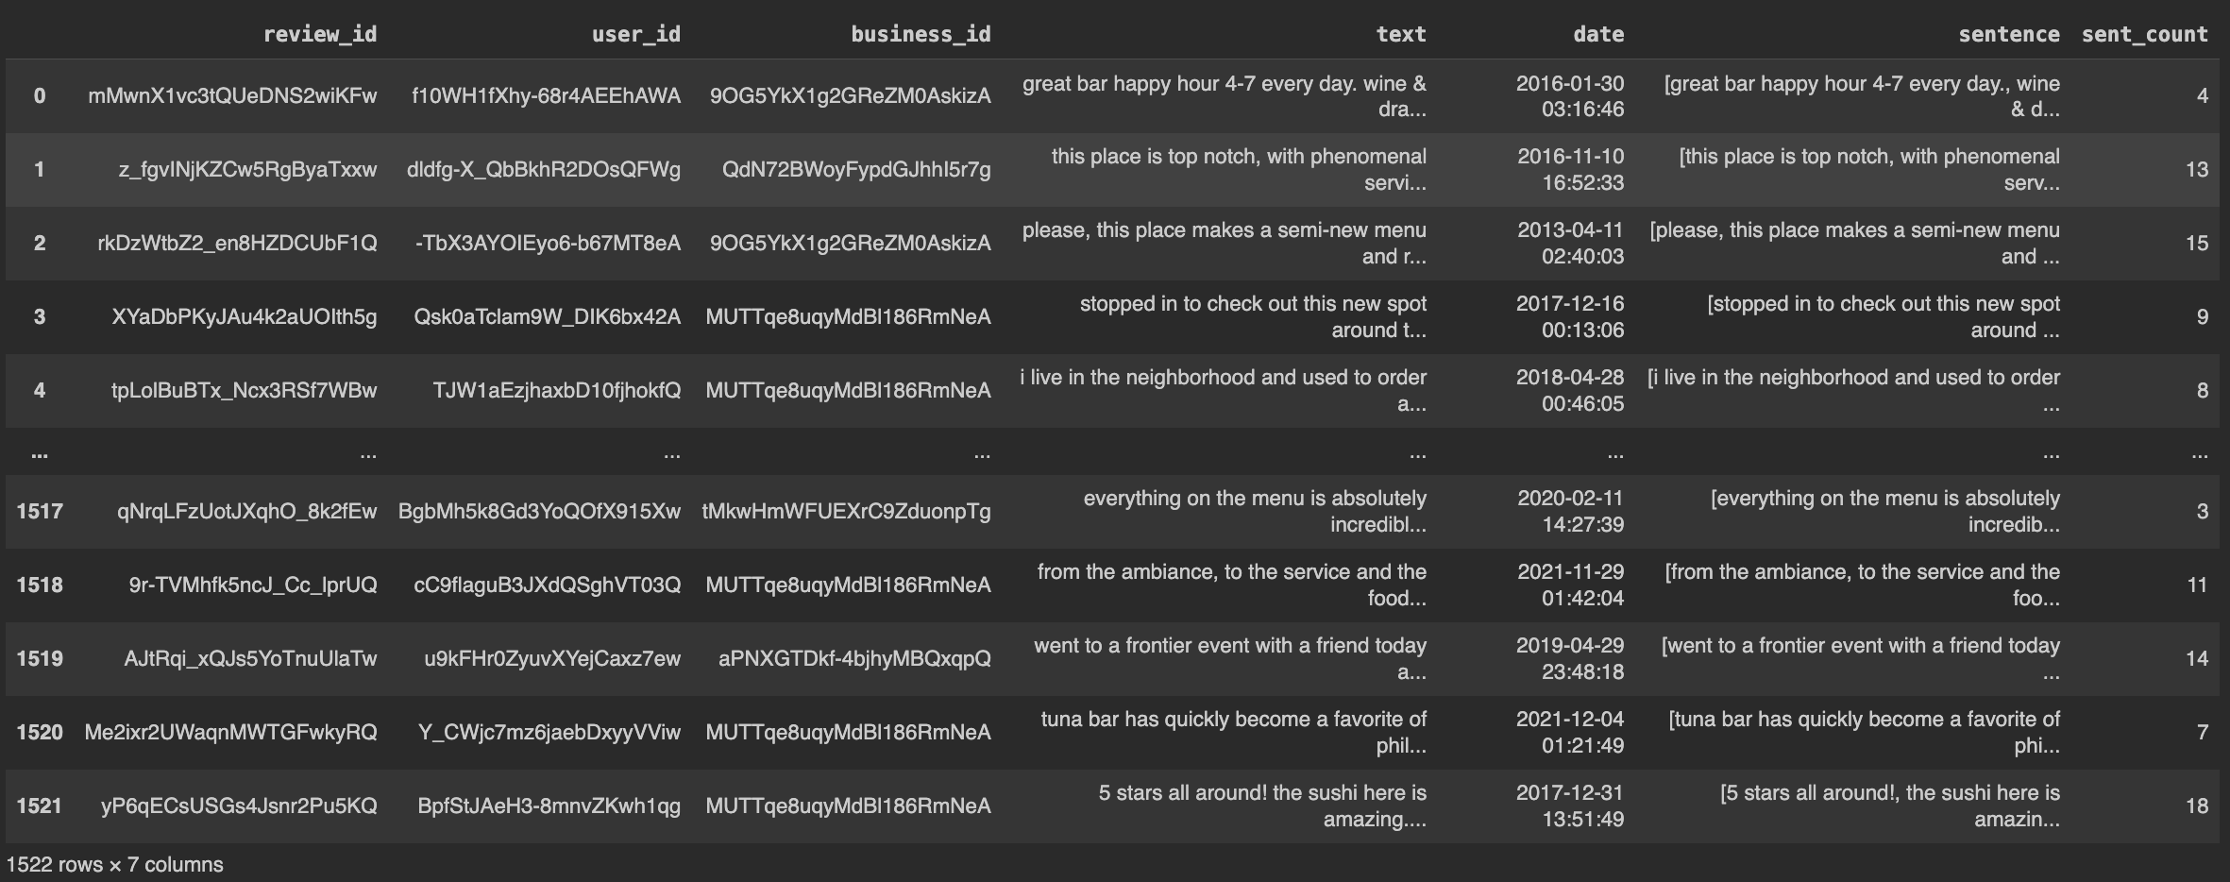
2. Generating Sentence Count
Calculating the number of sentences for each review.
It helps in analyzing the strength of each review.

Slide 13
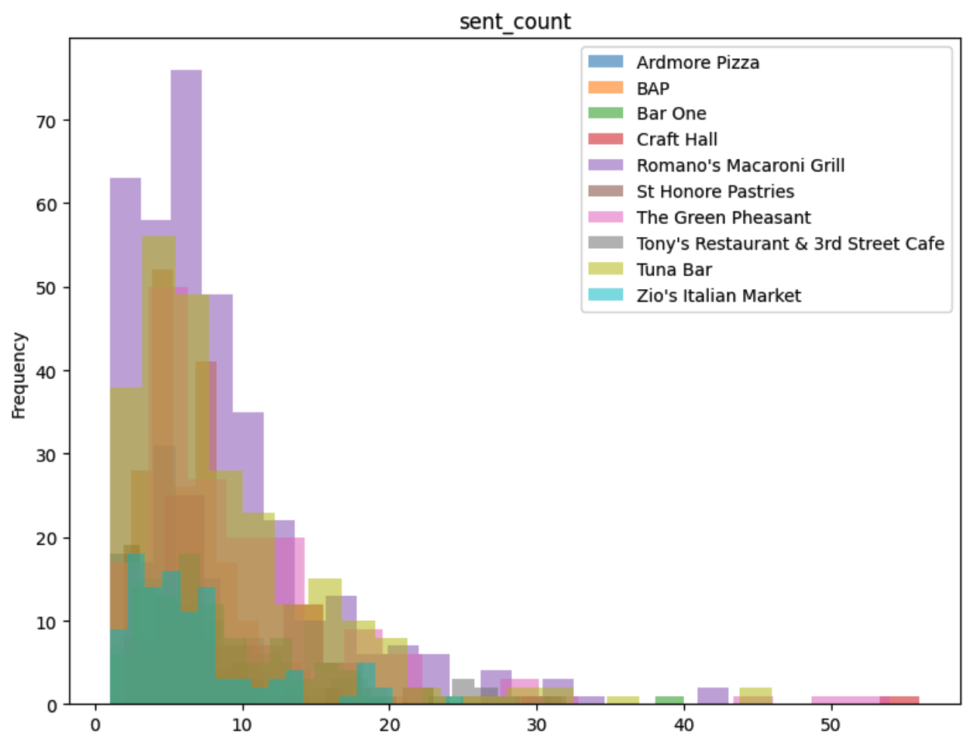
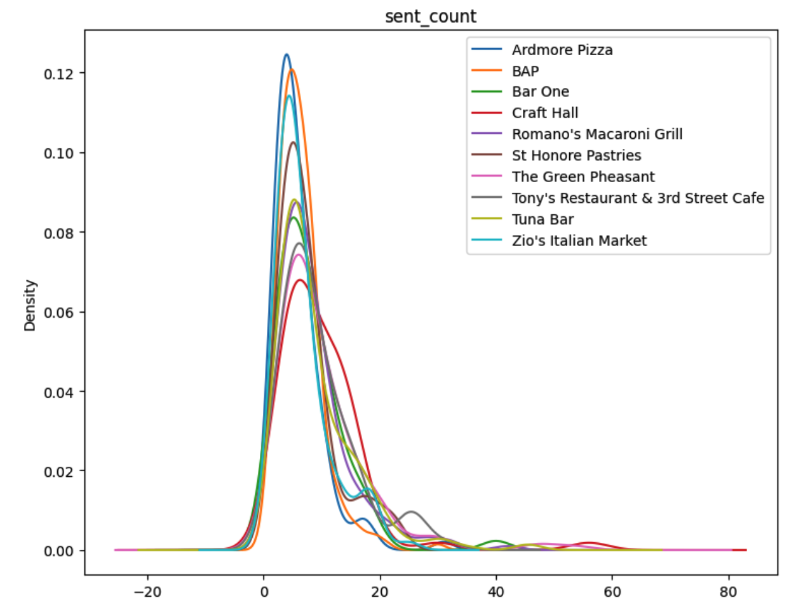
2. Generating Sentence Count
Depiction:
The above histogram gives a clear idea that the number of reviews having 7-8 sentences is the highest, and reviews with more than 20 sentences are very low.
Depiction:
The above Kernal Density Estimation plot shows that the number of reviews with sentence counts between 0 to 20 have high density.

Slide 14
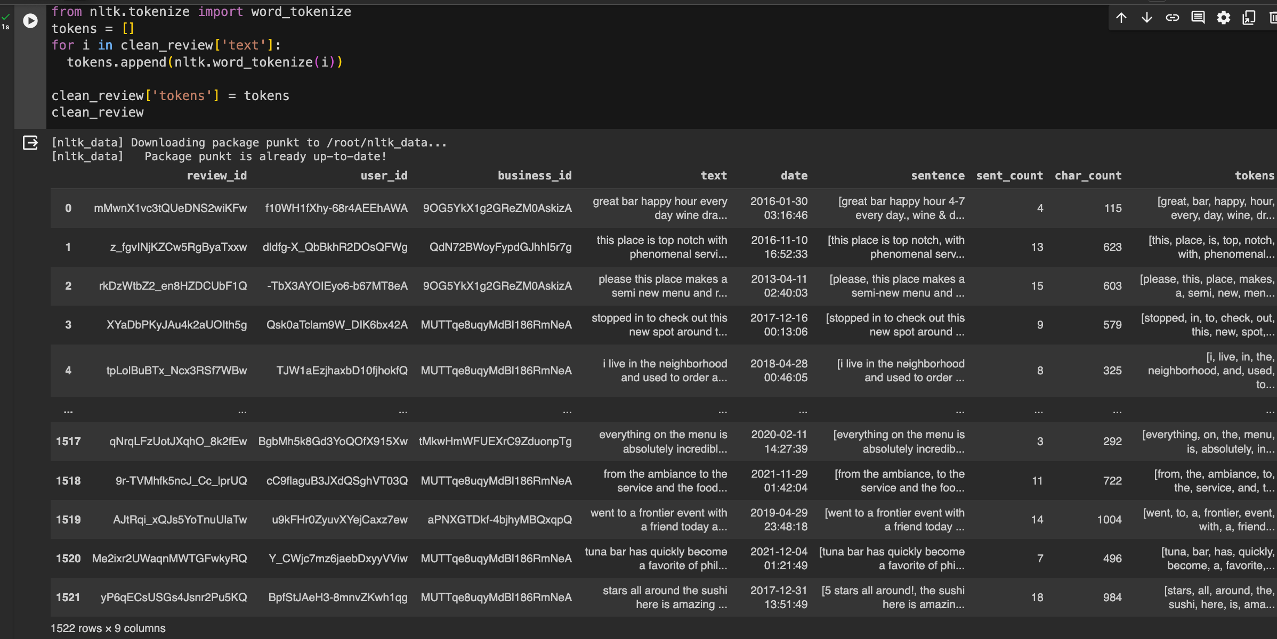
3. Word Tokenization before removing stop words
Each word is considered as a token.
Word tokenization is done using the NLTK library.

Slide 15
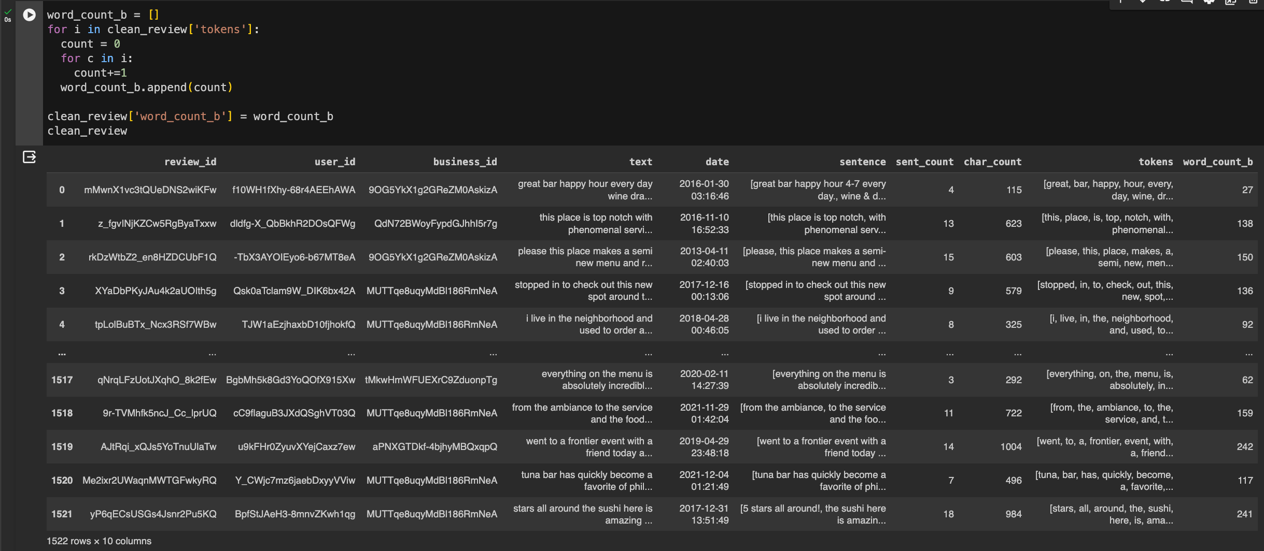
4. Generating Word Count before removing stop words
Calculating the number of words for each review before removing stop words.

Slide 16
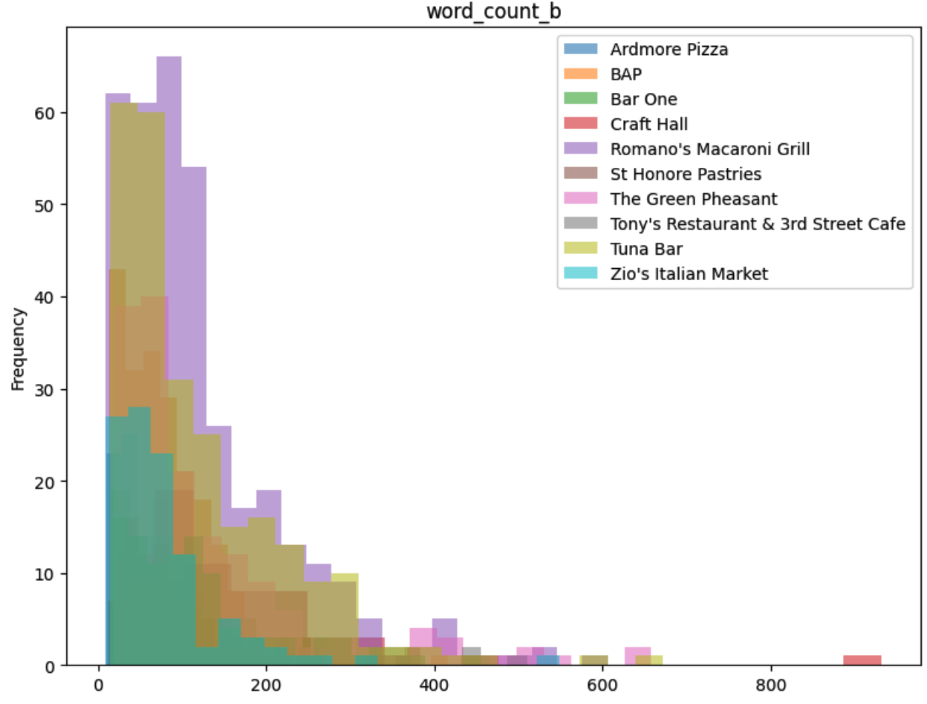
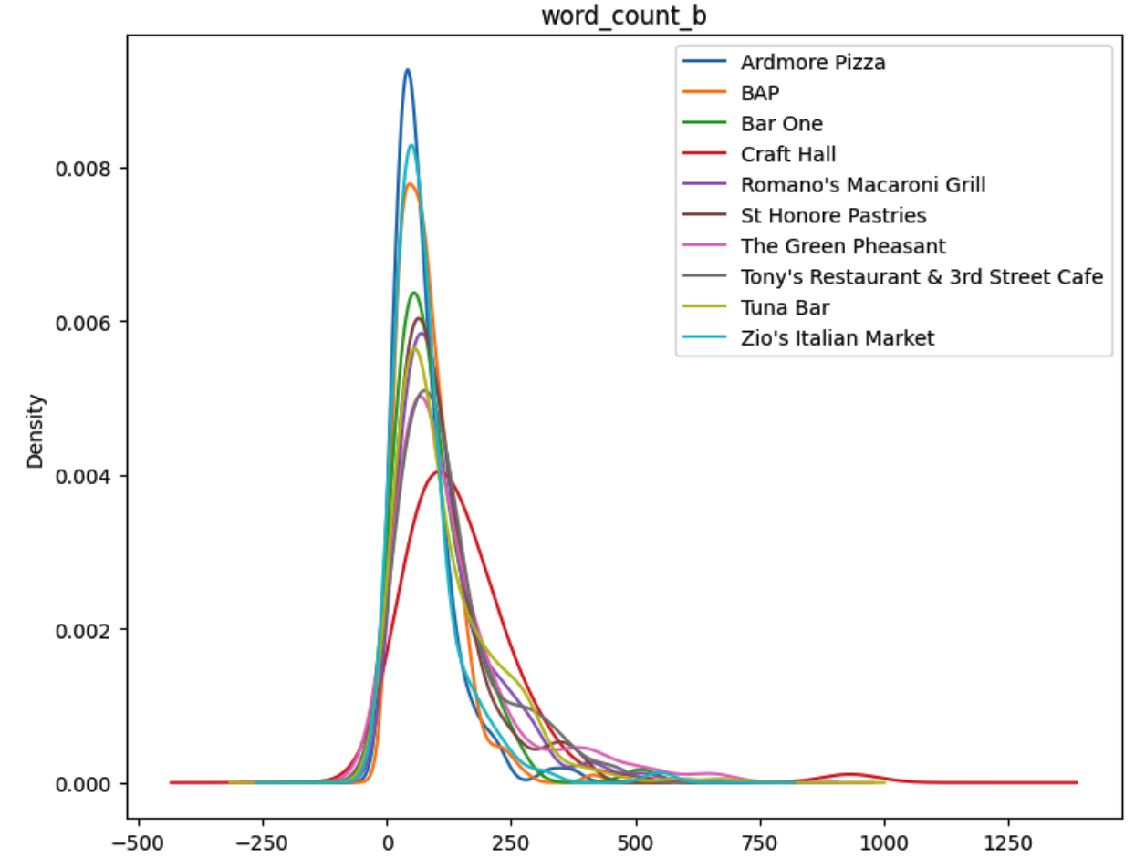
4. Generating Word Count before removing stop words
Depiction:
The above histogram gives a clear idea that the number of reviews having 0 to 150 words is high, and reviews with more than 400 words are very low.
Depiction:
The above Kernal Density Estimation plot shows that the number of reviews with a word count between 20 to 150 have high in density.

Slide 17
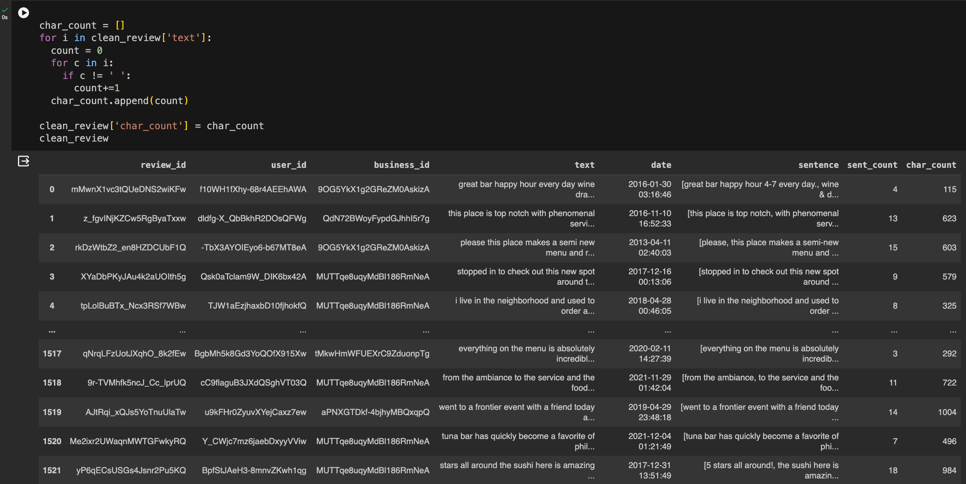
5. Generating Character Count before removing stop words
We are calculating the character count of each review given by the user before removing the stop words.

Slide 18
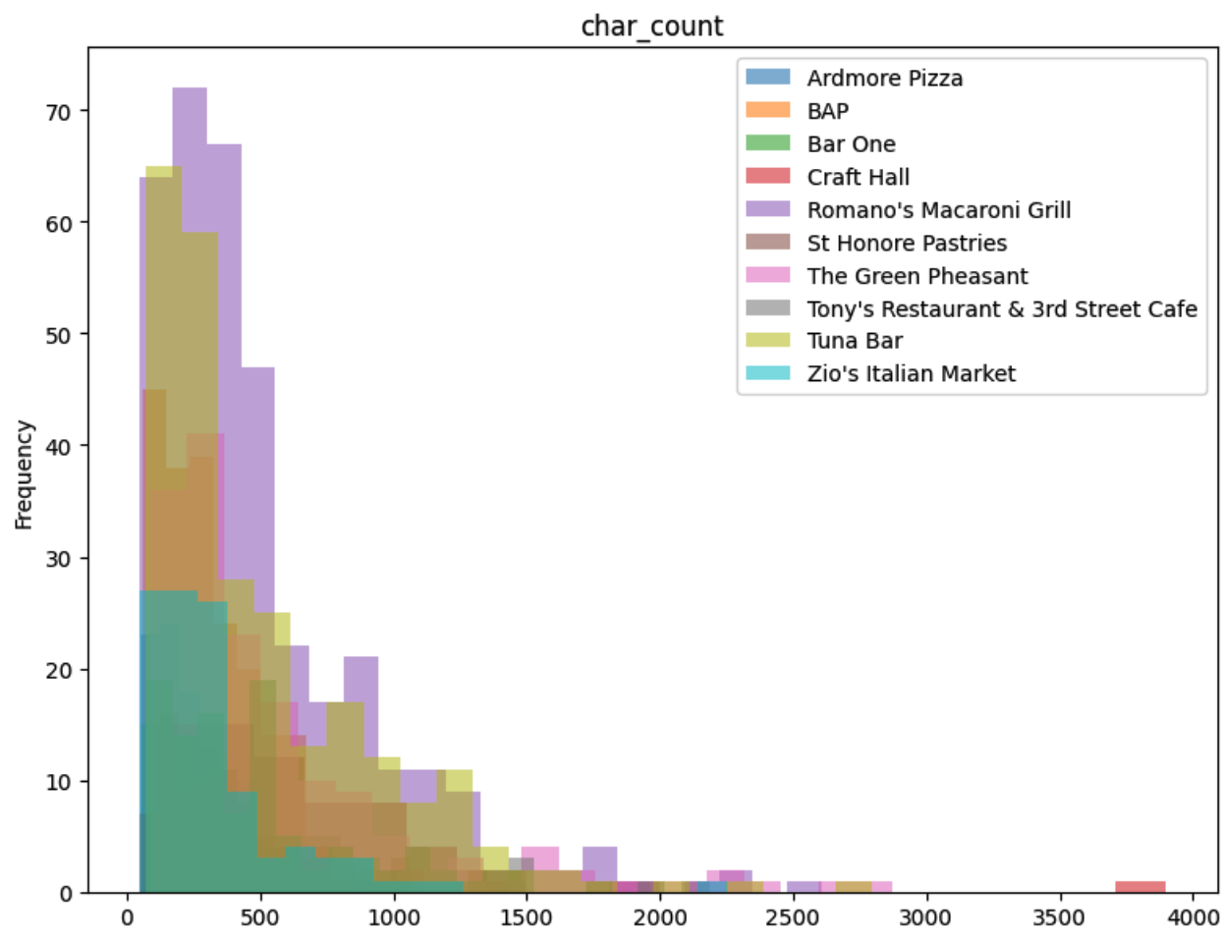
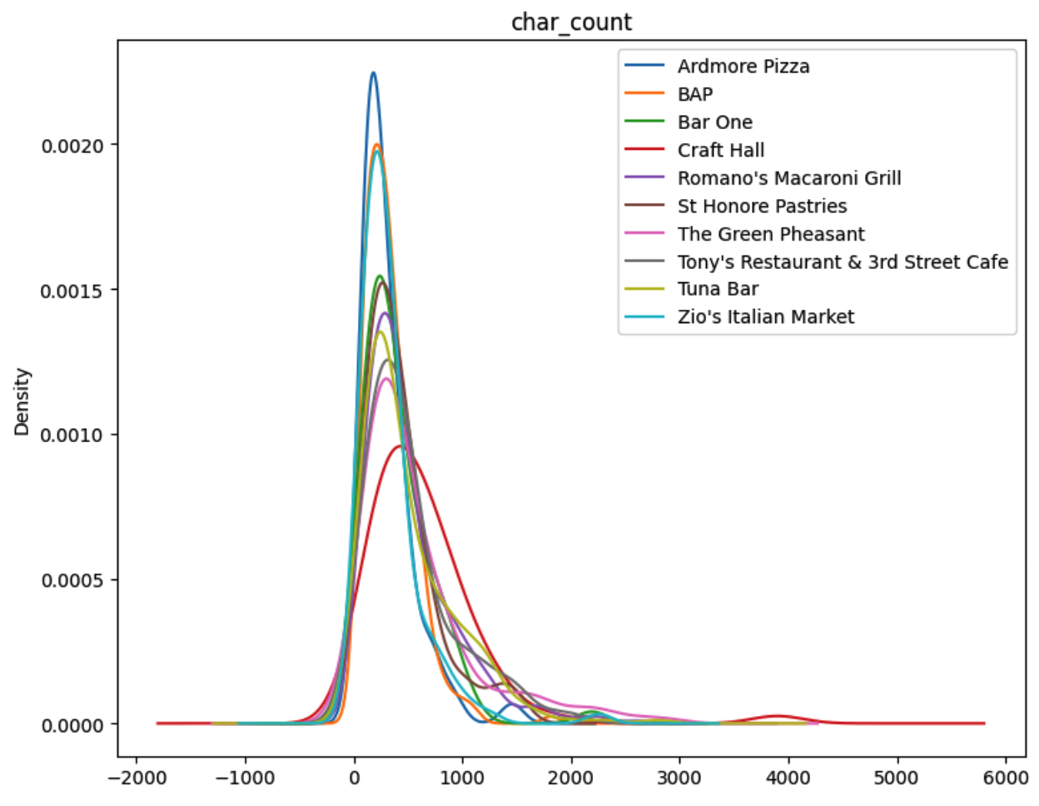
5. Generating Character Count before removing stop words
Depiction:
The above histogram gives a clear idea that the number of reviews having 0 to 500 characters is high, and reviews with more than 1500 characters are very low.
Depiction:
The above Kernal Density Estimation plot shows that the number of reviews with a character count between 0 to 1500 is high in density.

Slide 19
Exploratory Data Analysis
Data Pre-processing

Slide 20
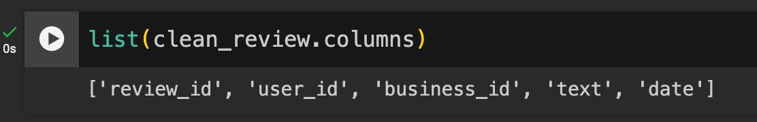
1. Feature extraction:
Extract only useful attributes like review_id, user_id, business_id, text, and date from the review dataset. Eliminated unwanted columns like stars, useful, funny, and cool.

Slide 21
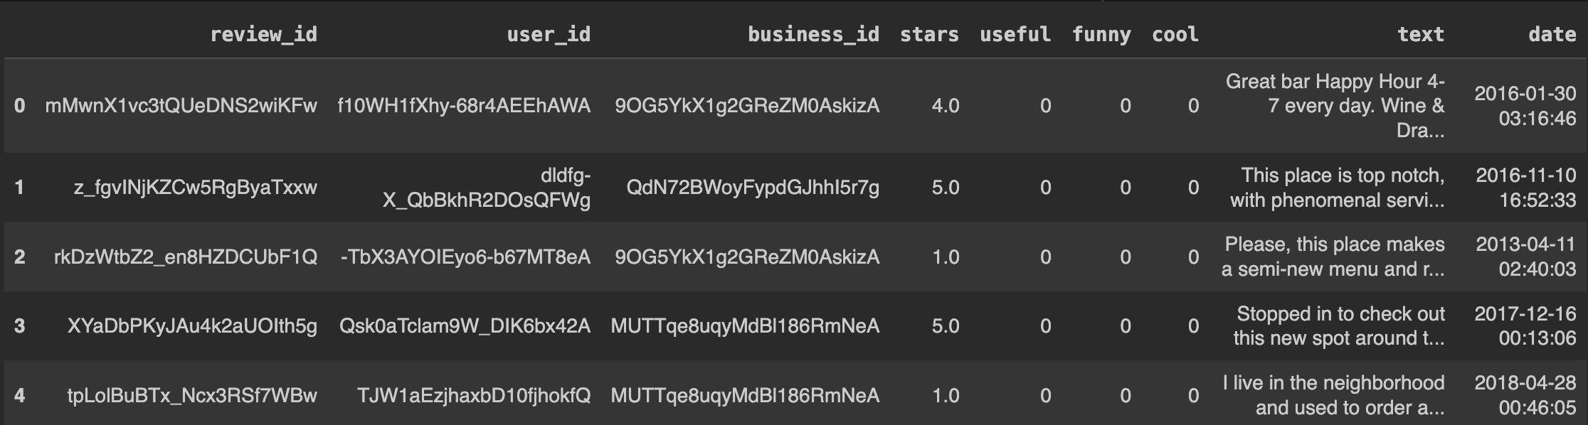
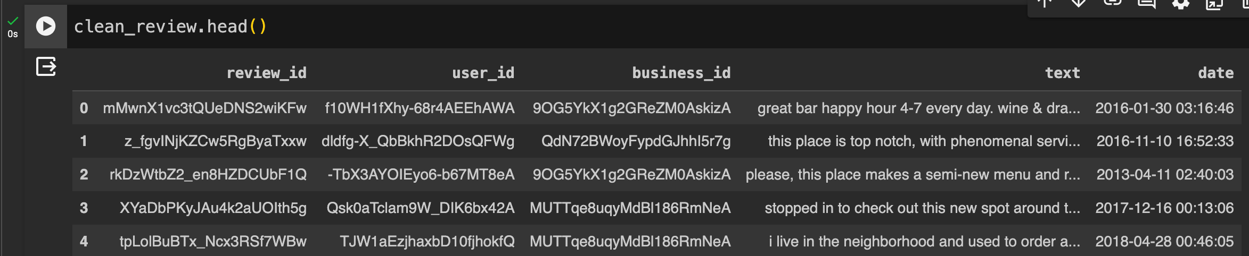
2. Case Conversion
Convert the text to lowercase alphabets, making summarization convenient.

Slide 22
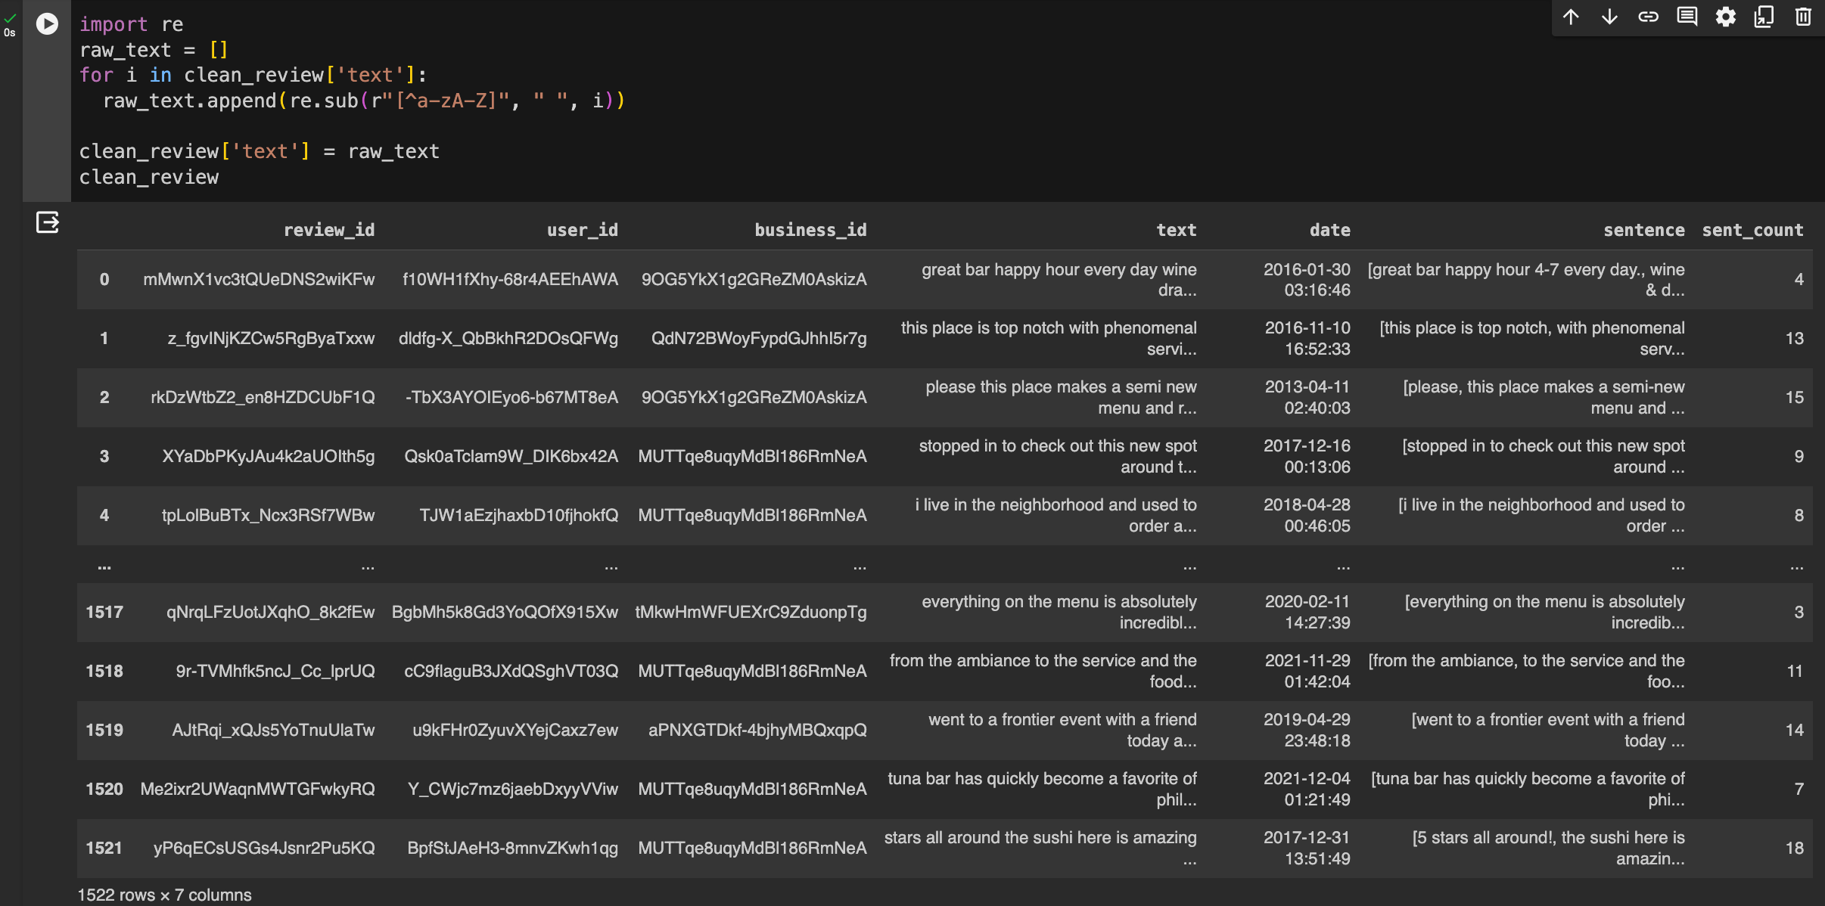
3. Eliminating non-alphabetical characters
Remove all the characters that are not alphabets to maintain simplicity when summarization. Consistency is also maintained which helps to focus on the original content hence improving the model performance.

Slide 23
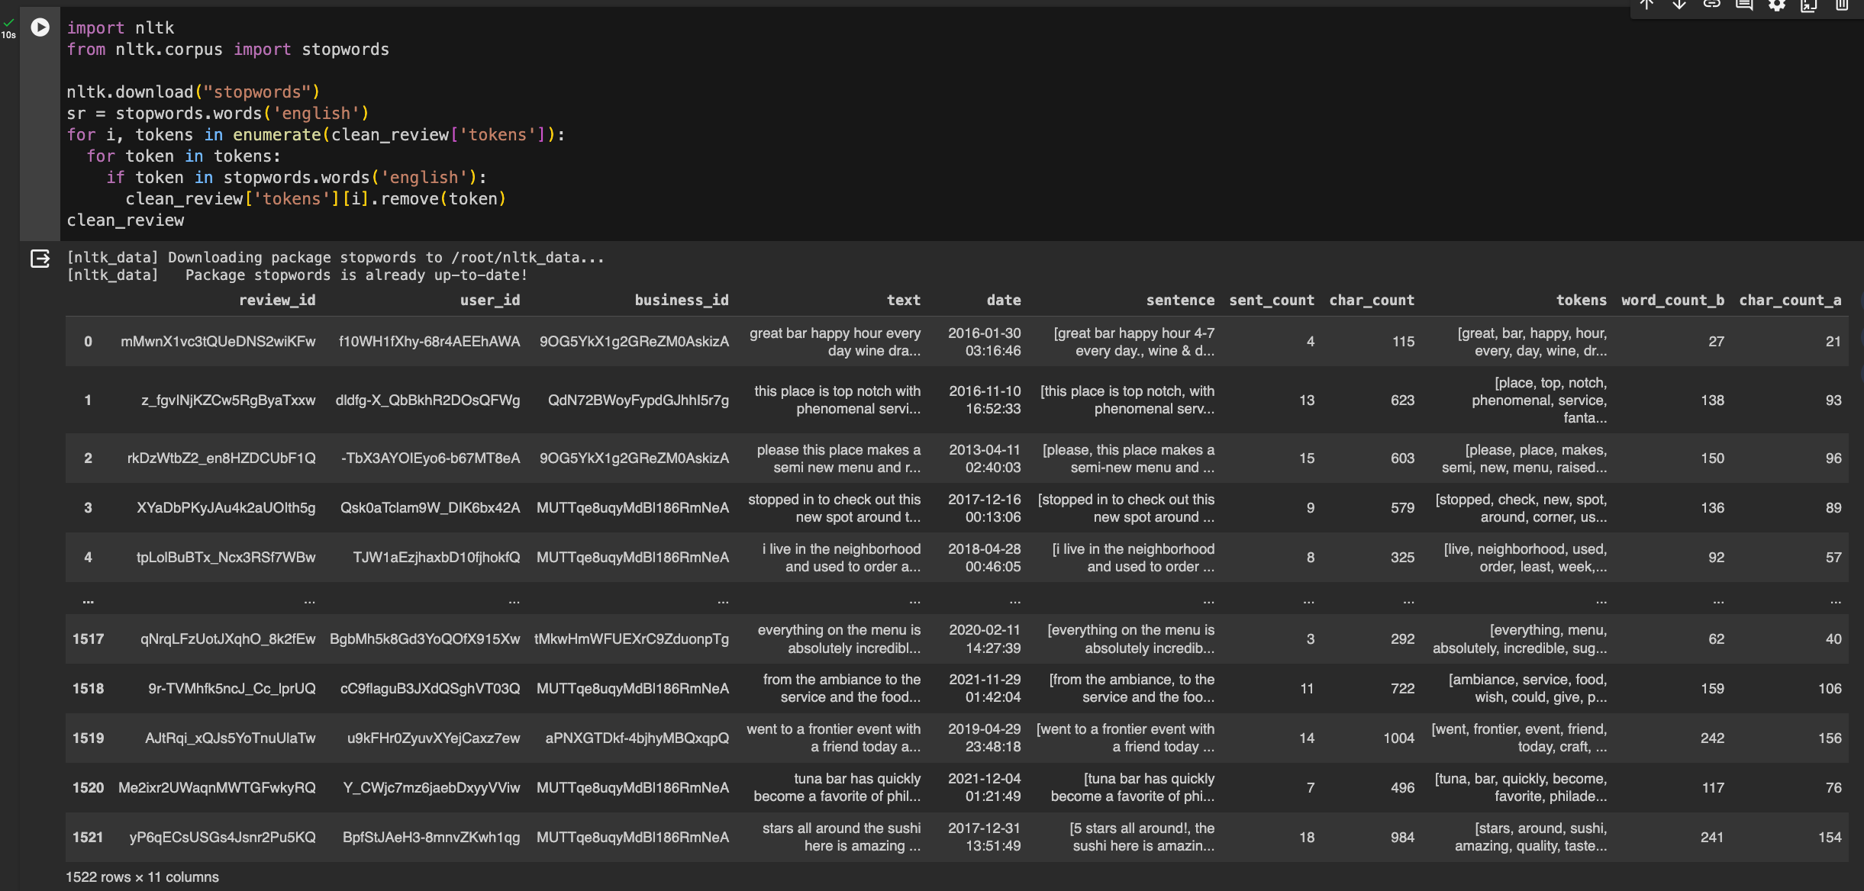
4. Remove Stop words
The stop words like ‘the’, ‘this’, ‘in’, etc are removed from the tokens
It is important because it removes all the unimportant words which improves the accuracy of the text summarization and sentiment analysis.

Slide 24
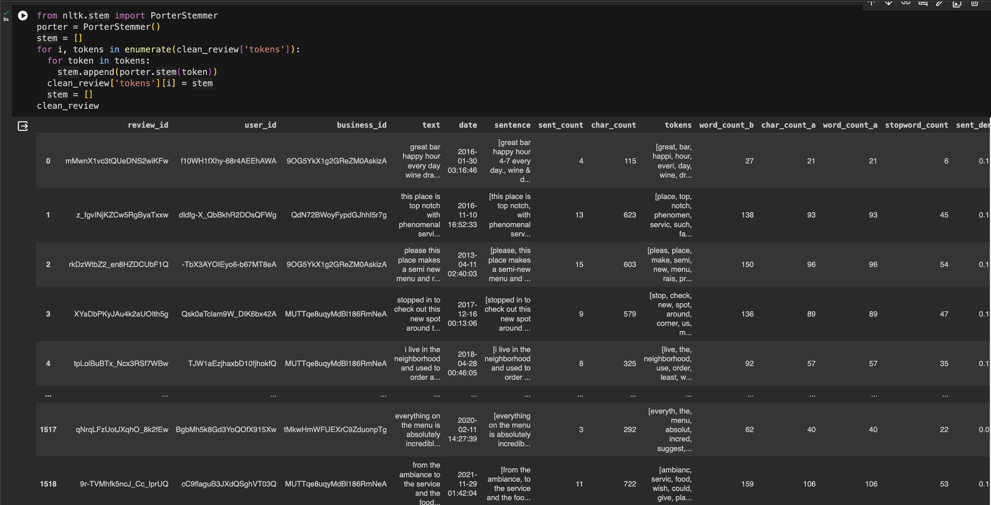
5. Stemming
The above code uses PorterStemmer on tokens to reduce the words to their base word or the root word.
This is done to improve the text summarization and improve the correctness of the result.

Slide 25
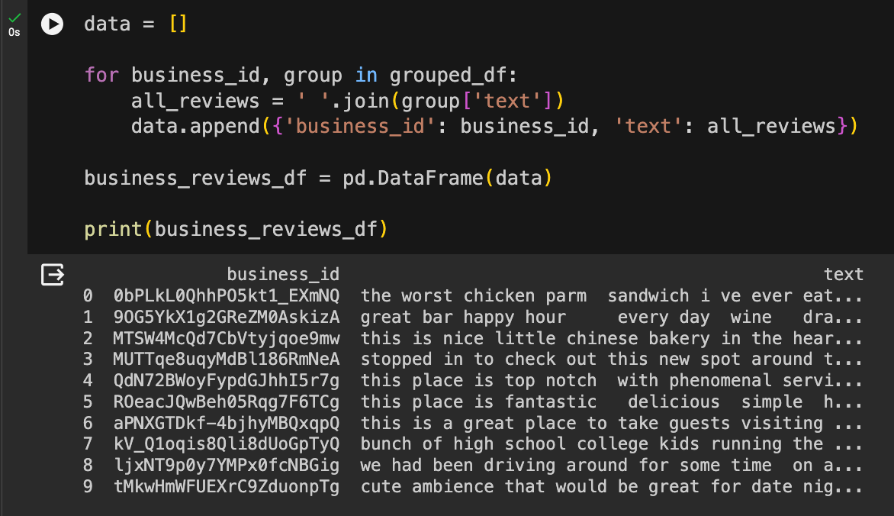
6. Spelling Correction
Correct the spellings using SpellChecker.
This is an important step in order to make sure that there are no errors which text summarization.
7. Merge data
Since business information and reviews are in different JSON files, we need to combine them.
Create a new data frame that contains the merged information of business and reviews.

Slide 26
Exploratory Data Analysis
Data Visualization
after pre-processing

Slide 27
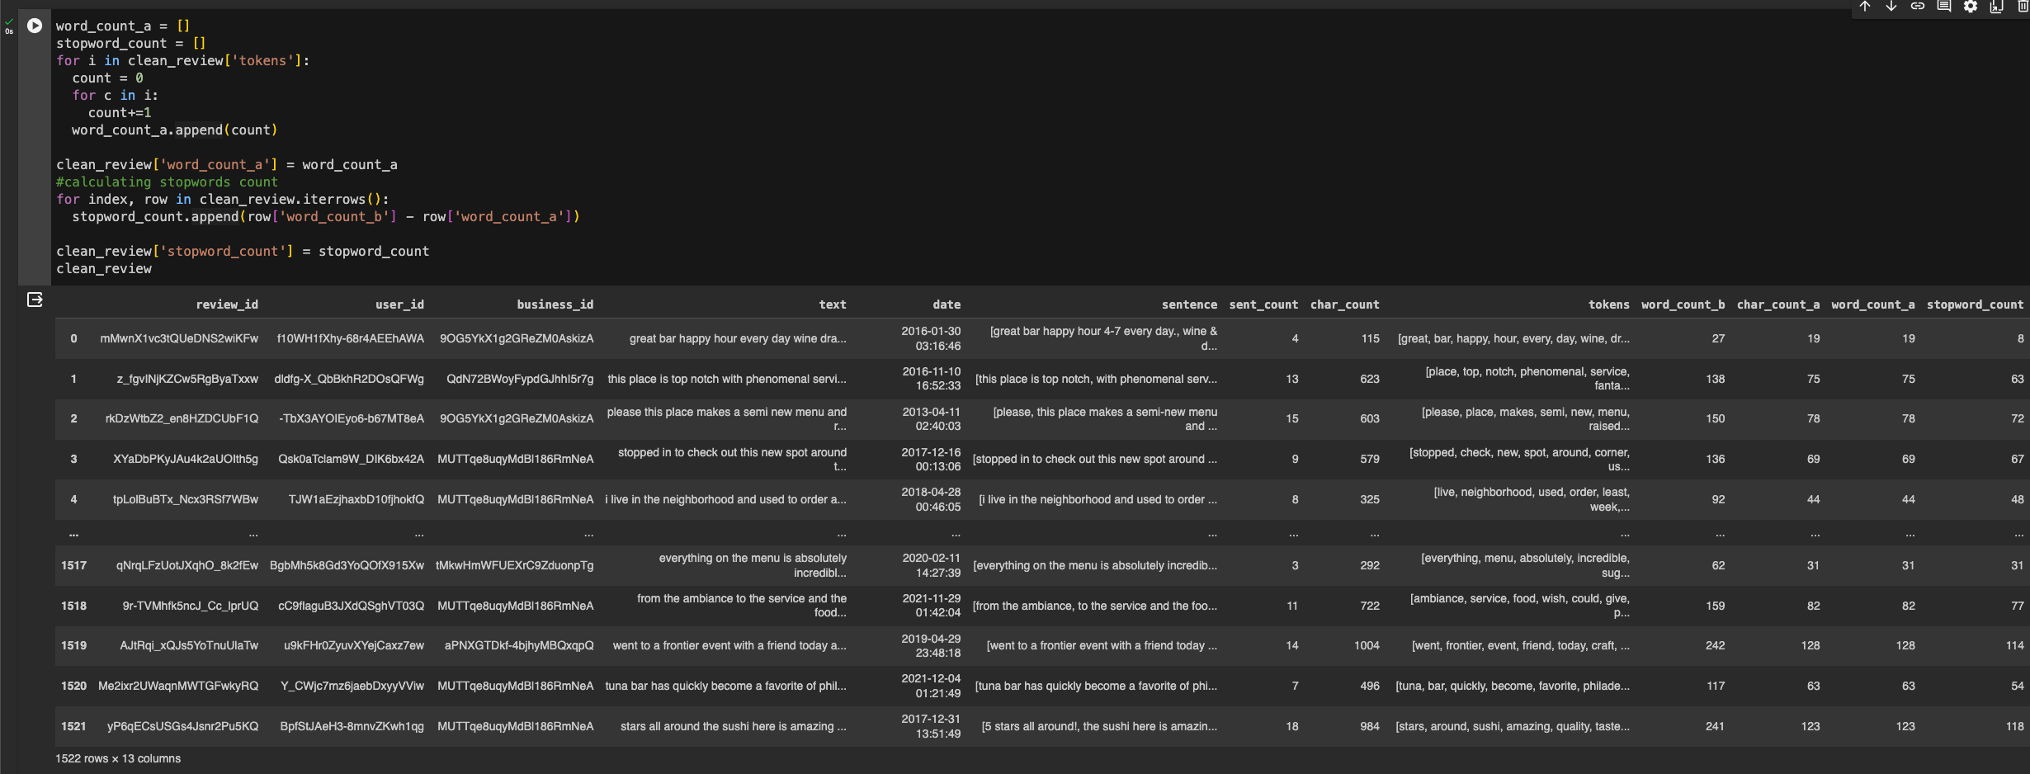
1. Generating Word Count after removing stop words
Calculating the number of words after removing stop words.

Slide 28
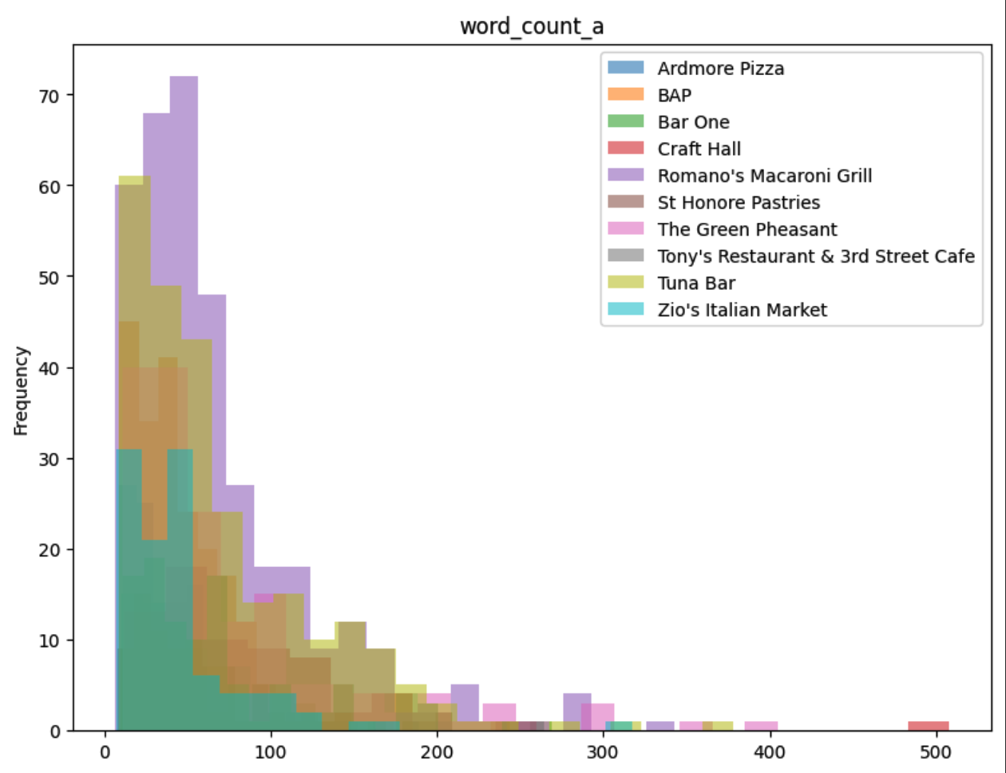
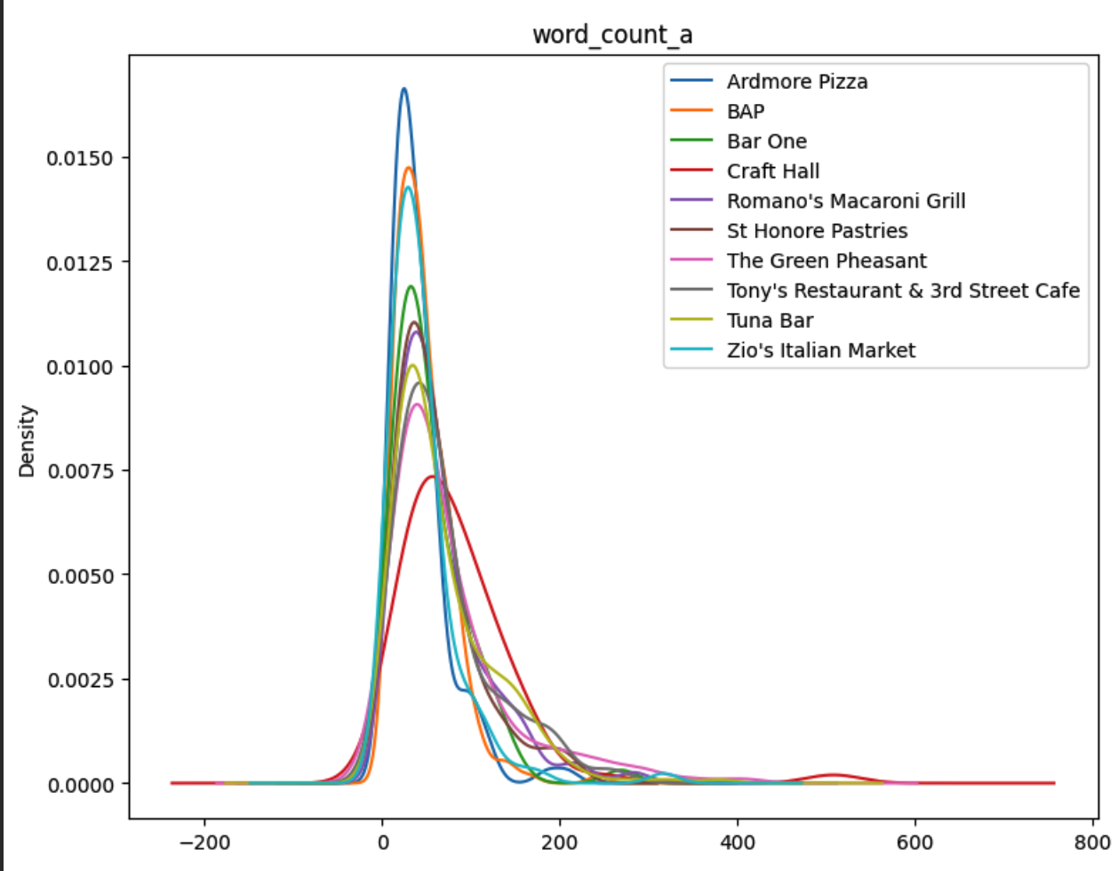
1. Generating Word Count after removing stop words
Depiction:
The above histogram gives a clear idea that the number of reviews having 0 to 110 words is high, and reviews with more than 220 words are very low after removing the stop words.
Depiction:
The above Kernal Density Estimation plot shows that the number of reviews with a word count between 10 to 100 has high density after removing the stop words.

Slide 29
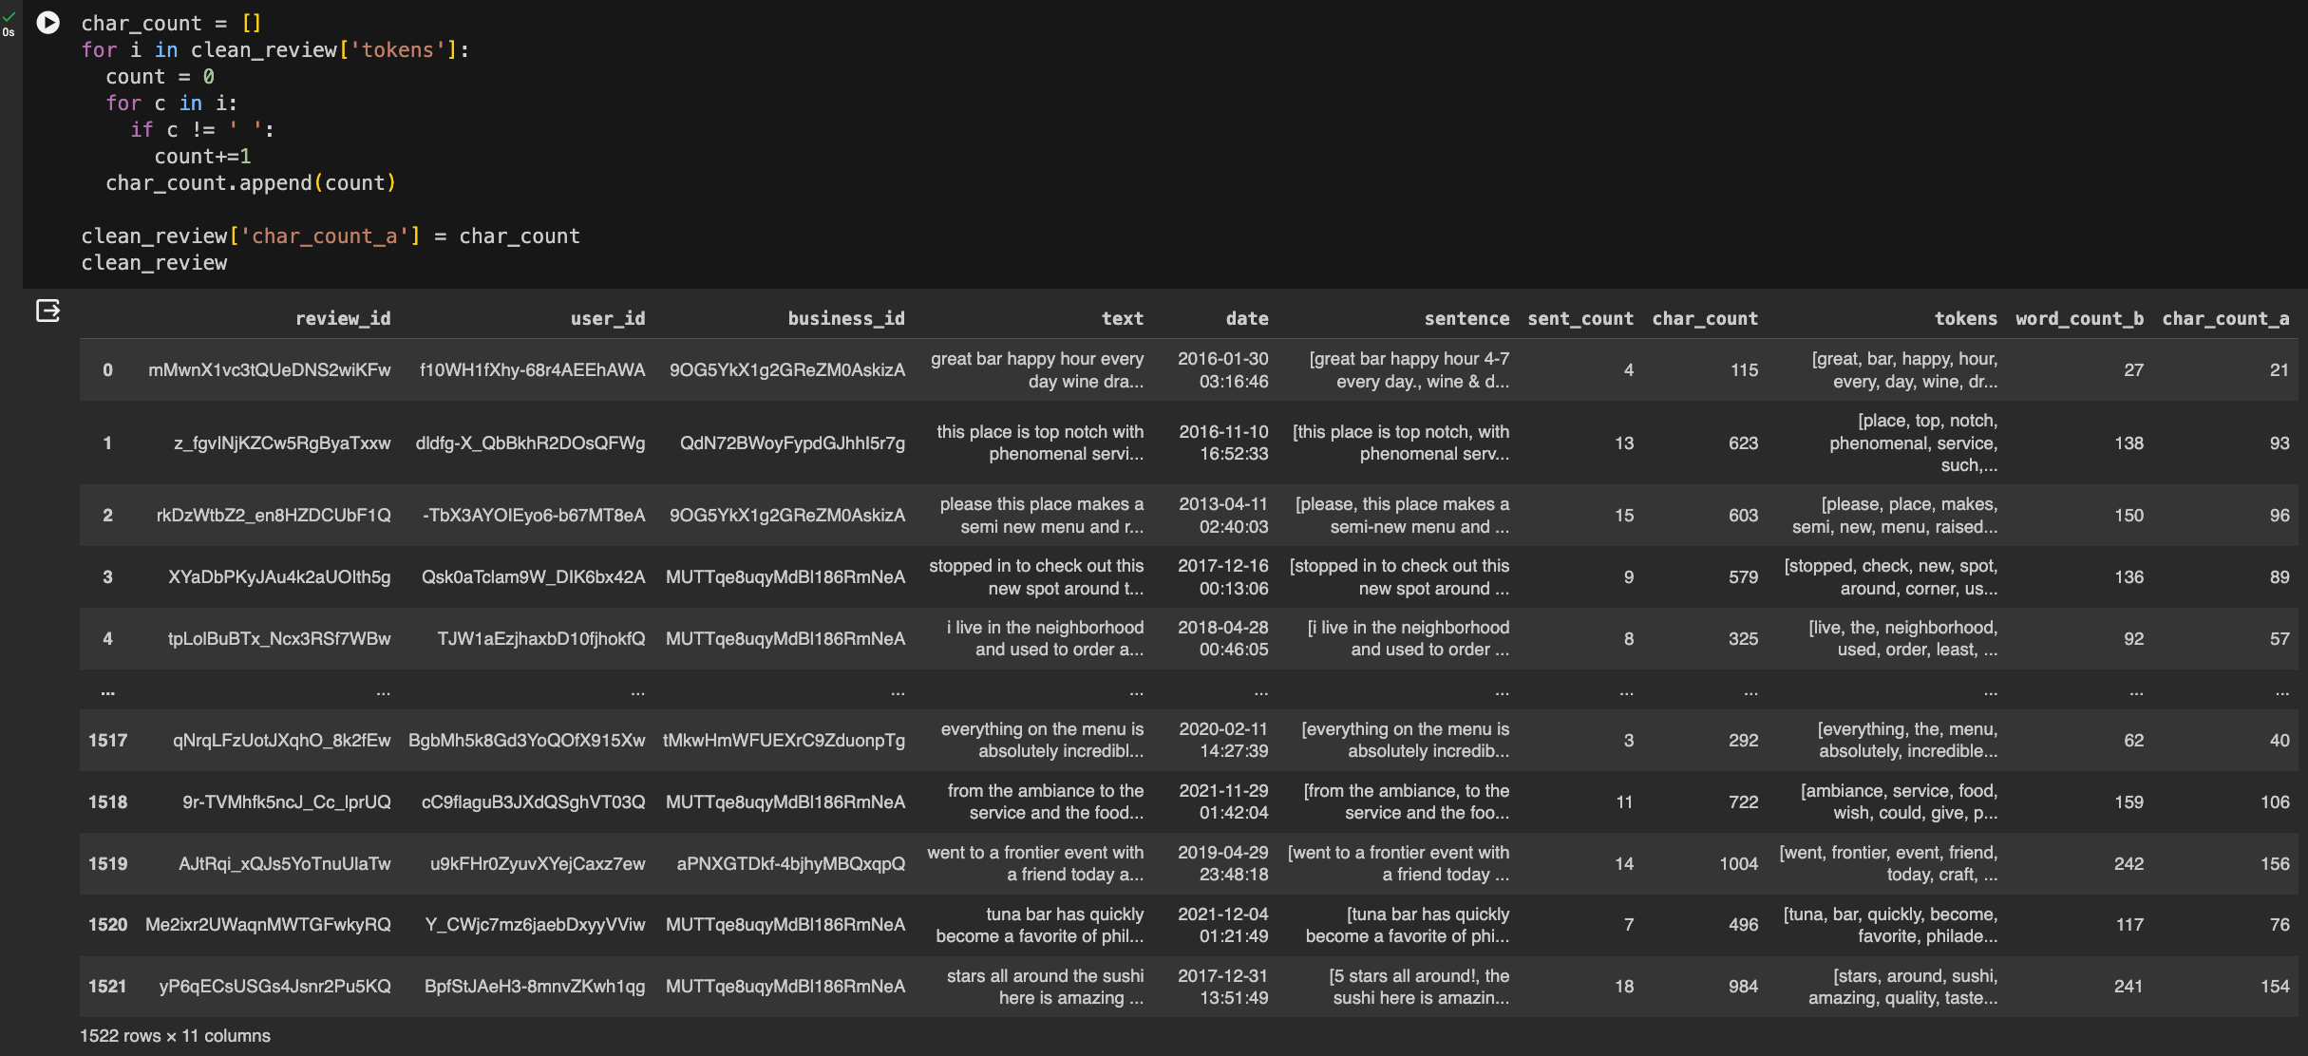
2. Generating Character Count after removing stop words
Calculating the number of characters for each review after removing stop words.
As you can see the number of characters have reduced after removing the stop words.

Slide 30

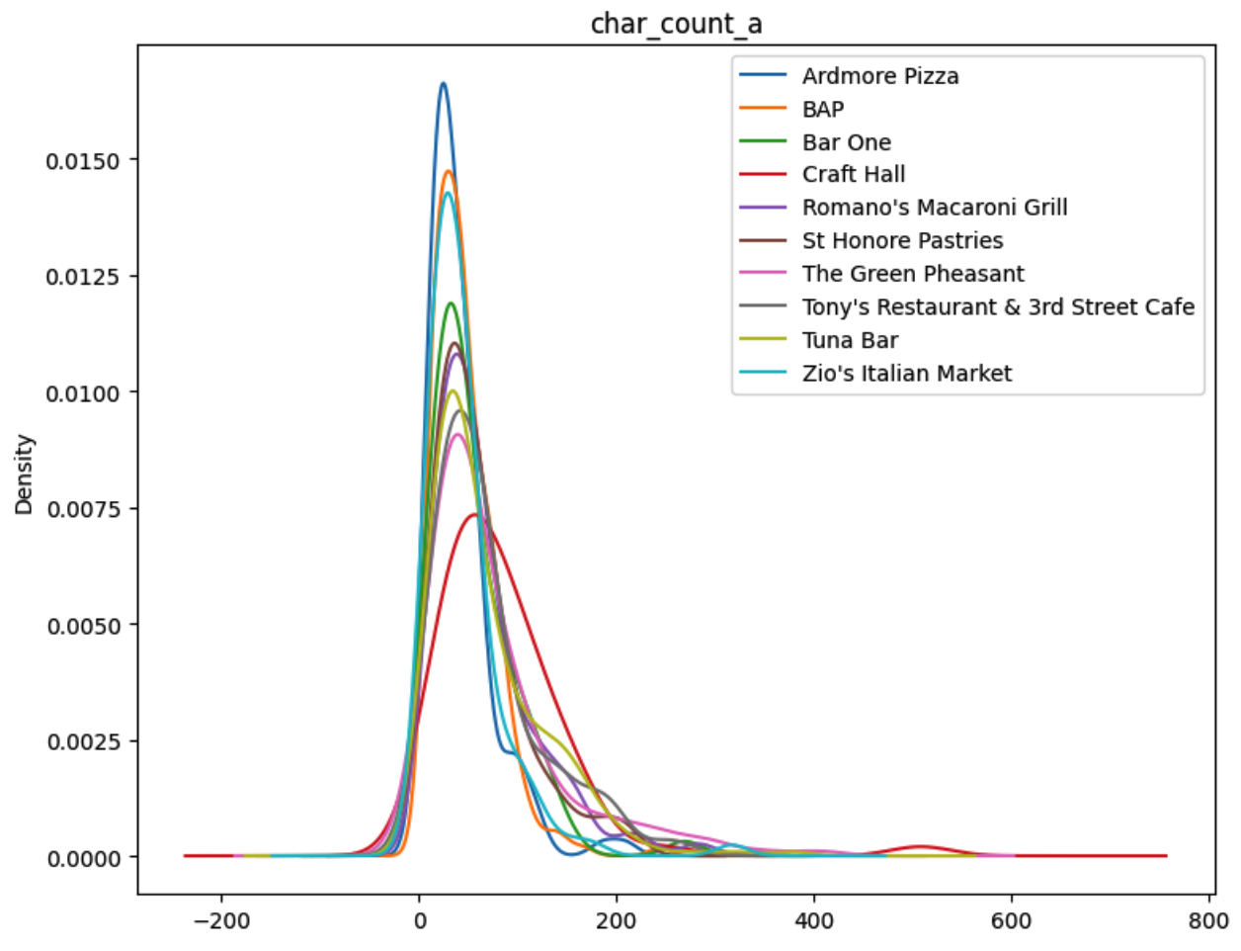
2. Generating Character Count after removing stop words
Depiction:
The above histogram gives a clear idea that the number of reviews having 0 to 100 characters is high, and reviews with more than 250 characters are very low after removing the stop words.
Depiction:
The above Kernal Density Estimation plot shows that the number of reviews with a character count between 10 to 150 ha s high density after removing the stop words.

Slide 31
3. Generating stop word count
Calculating the number of stop words for each review given by the user

Slide 32
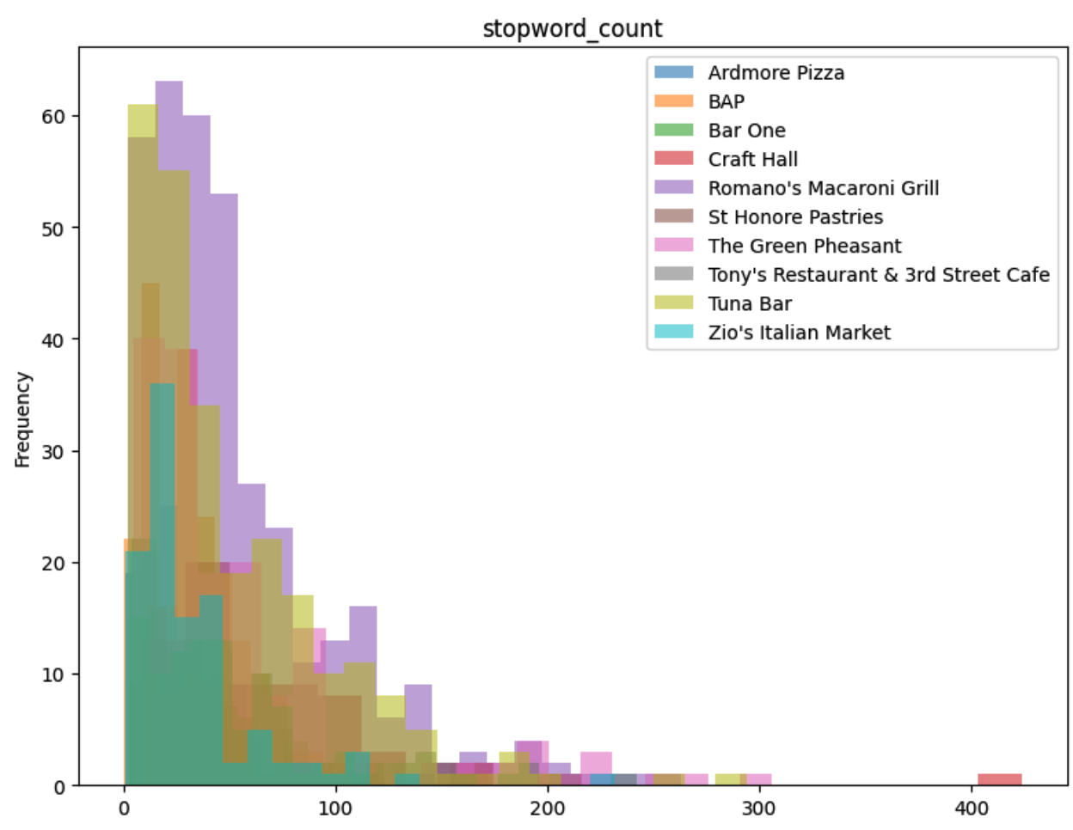
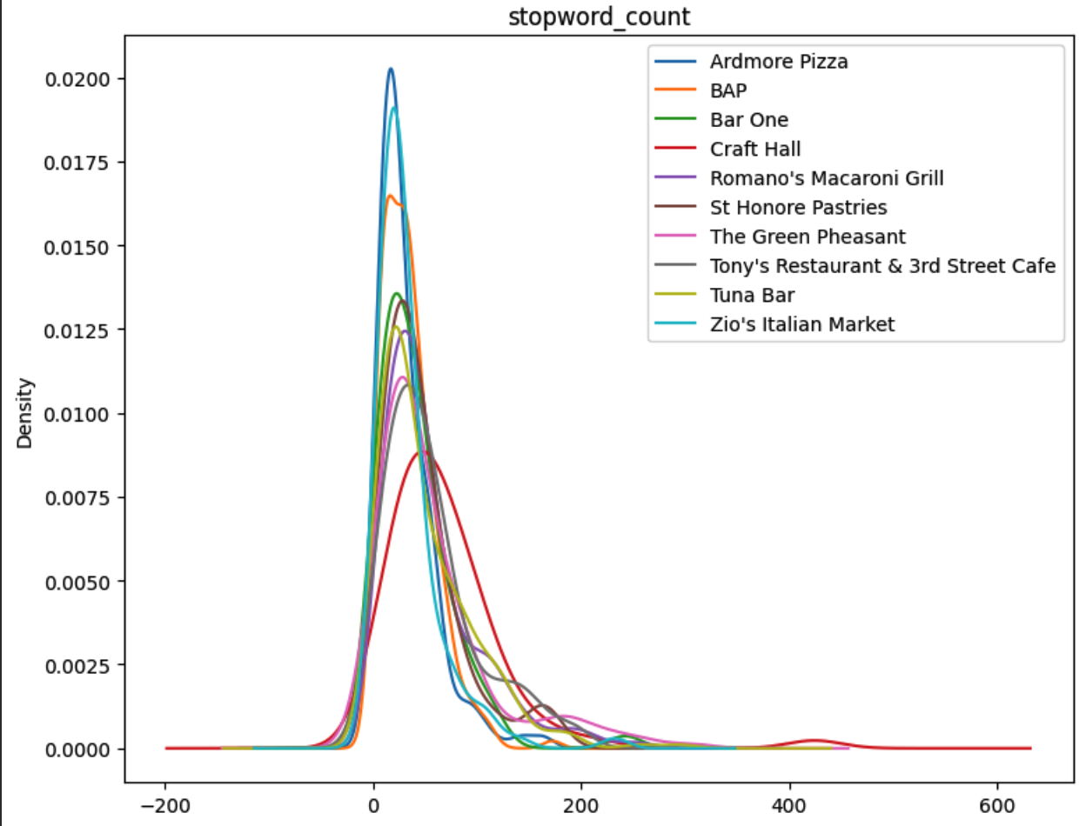
3. Generating stop word count
Depiction:
The above histogram gives a clear idea that the number of reviews having 20 to 60 stop words is high, and reviews with more than 170 characters are very low.
Depiction:
The above Kernal Density Estimation plot shows that the number of reviews with a stop word count between 10 to 60 has high density.

Slide 33
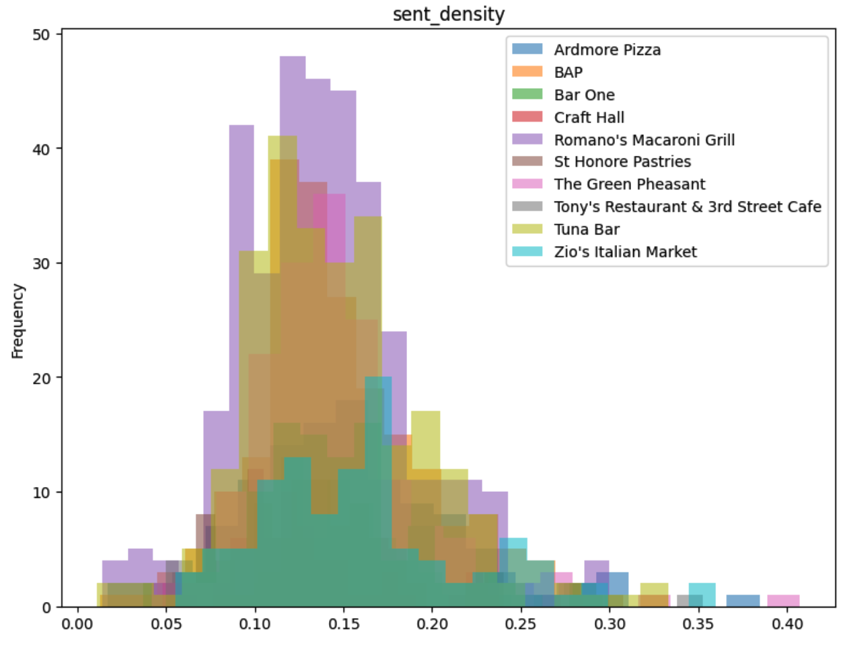
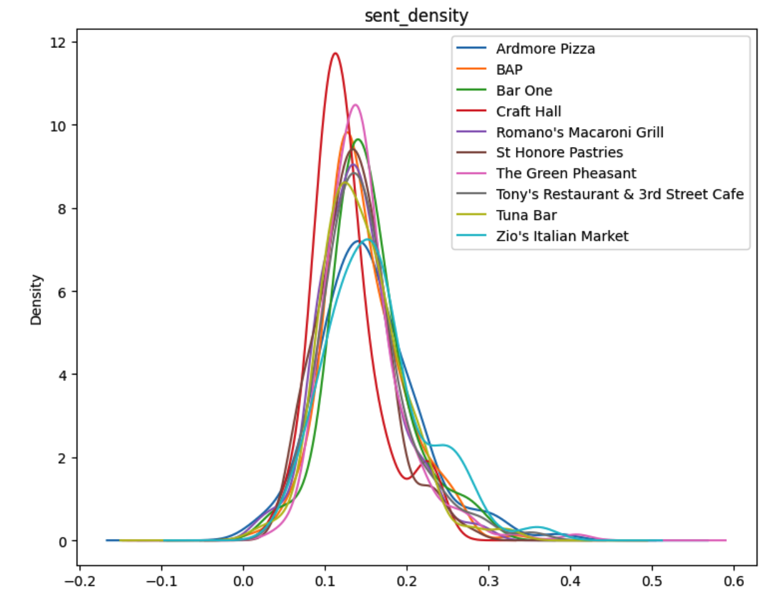
4. Sentence Density
Depiction:
The above histogram denotes the frequency of the sentence density.
Sentence with density 0.13 is highest.
Depiction:
The above Kernal Density Estimation plot denotes that there is a high density between 0.1 and 0.13.

Slide 34
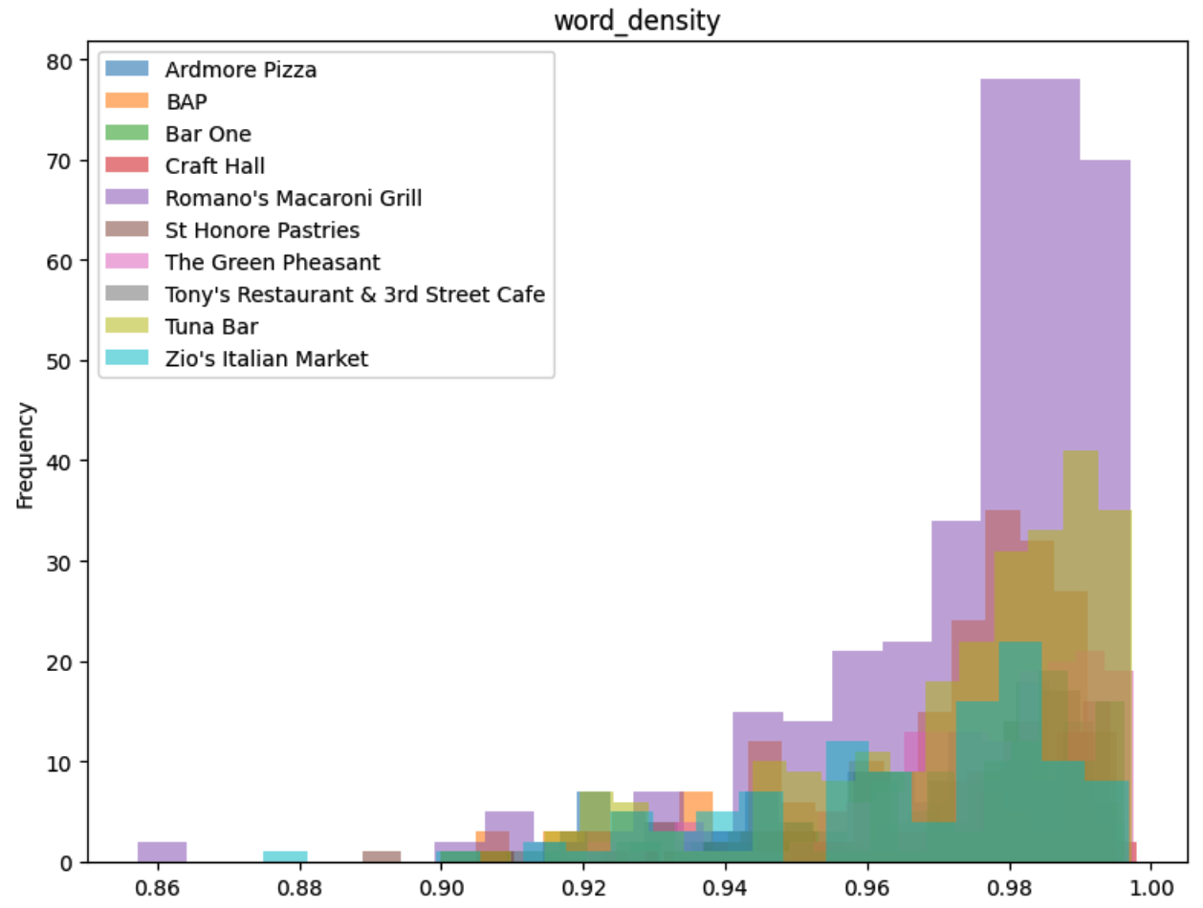
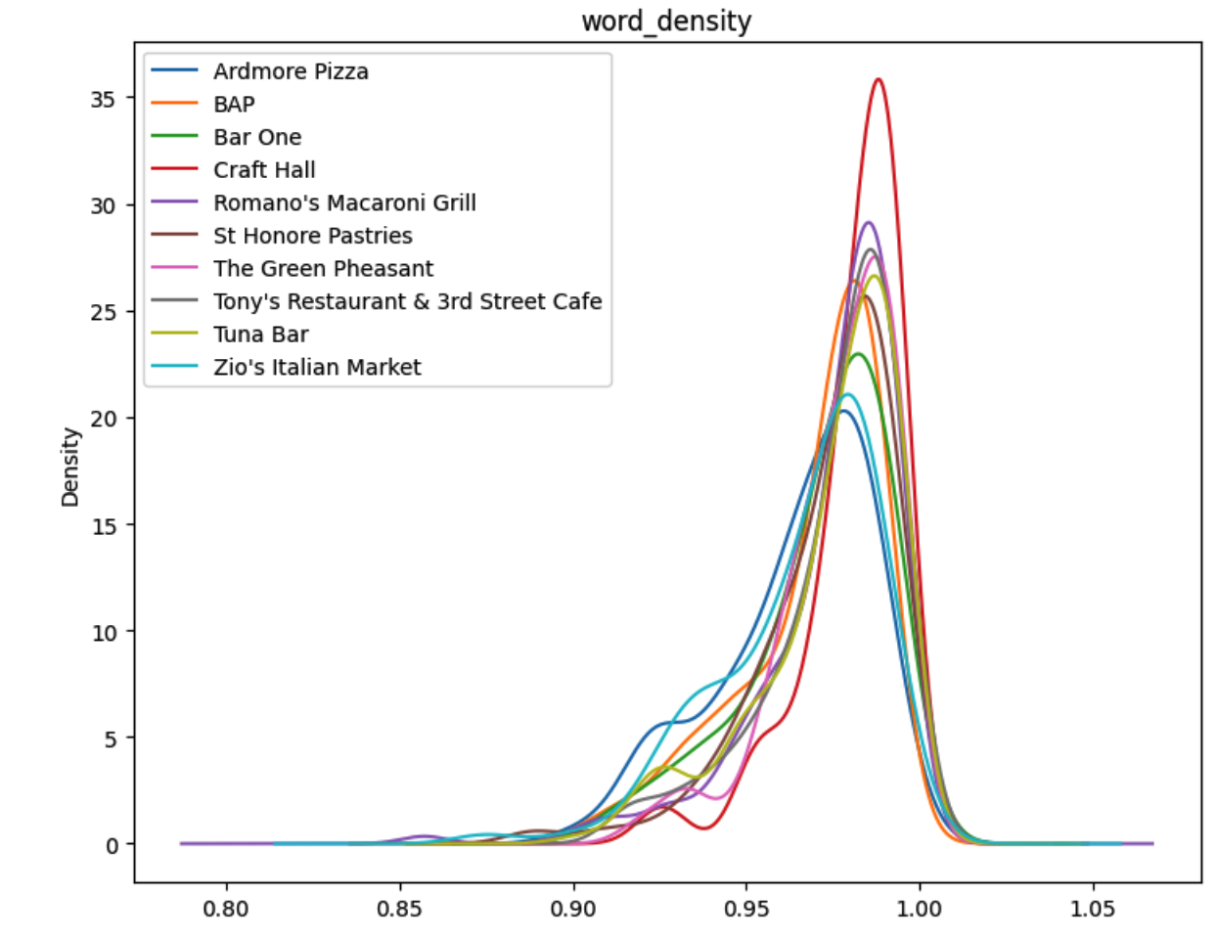
5. Word Density
Depiction:
The above histogram denotes the frequency of the word density.
Word with density 0.99 is highest.
Depiction:
The above Kernal Density Estimation plot denotes that there is a high density between 0.97 and 1.

Slide 35
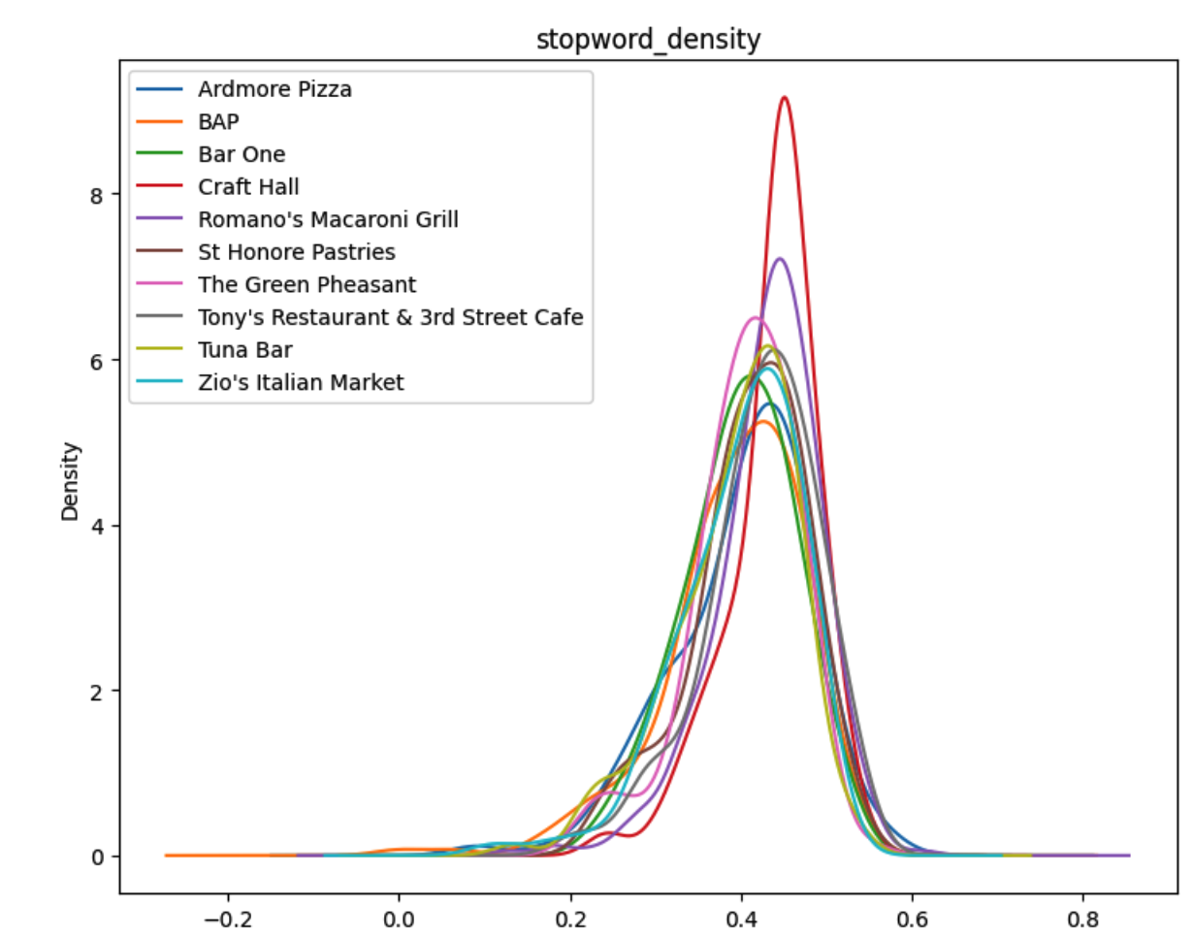
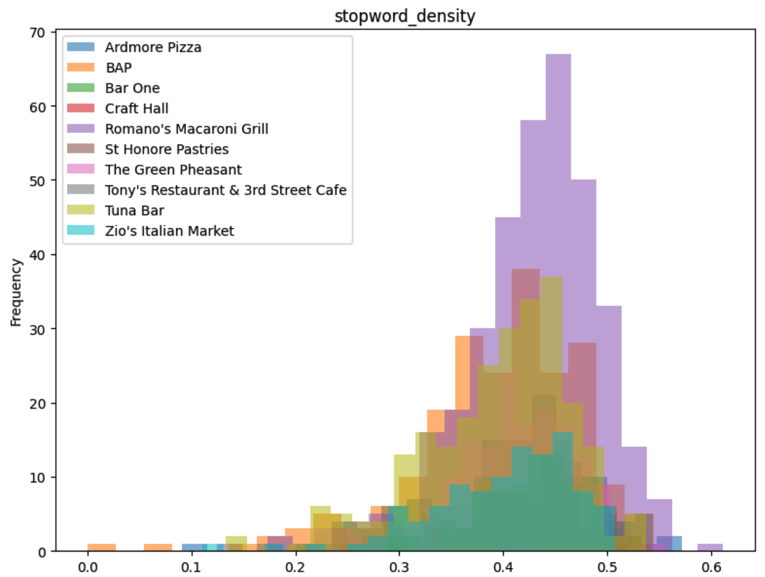
6. Stop Word Density
Depiction:
The above histogram denotes the frequency of the stop word density.
Stop word with density 0.38 is highest.
Depiction:
The above Kernal Density Estimation plot denotes that there is a high density between 0.37 and 0.4.

Slide 36
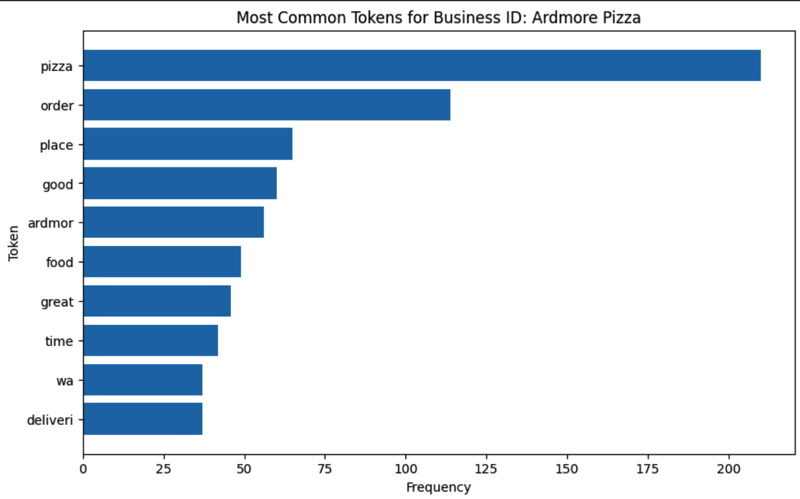
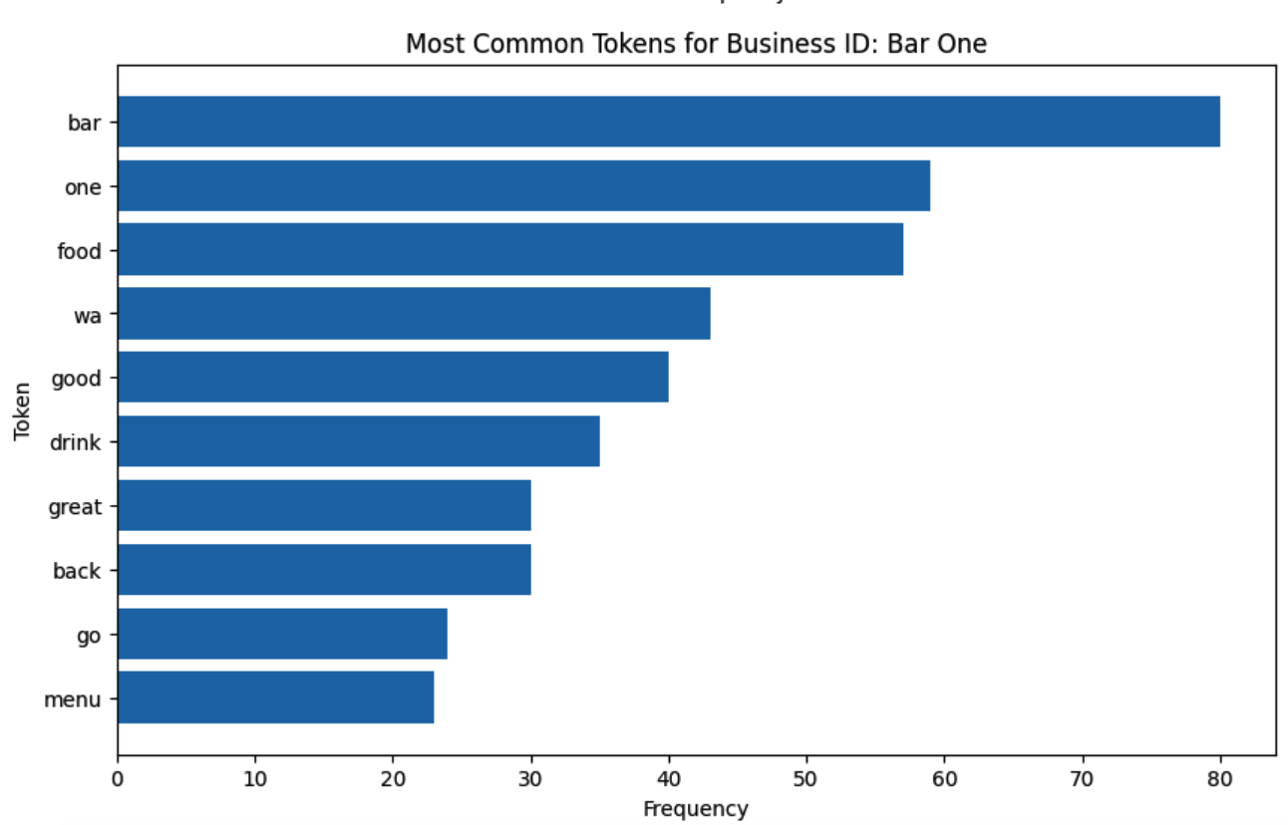
7. Most Common Tokens
Depiction:
The above bar graph gives the most common tokens used for each business.
This can be used to understand customer semantics.
For example in the first graph, the most common token used in the reviews is Italian. So if this business has an overall positive review that means people are liking Italian food.

Slide 37
Exploratory Data Analysis
Additional Data Visualization

Slide 38
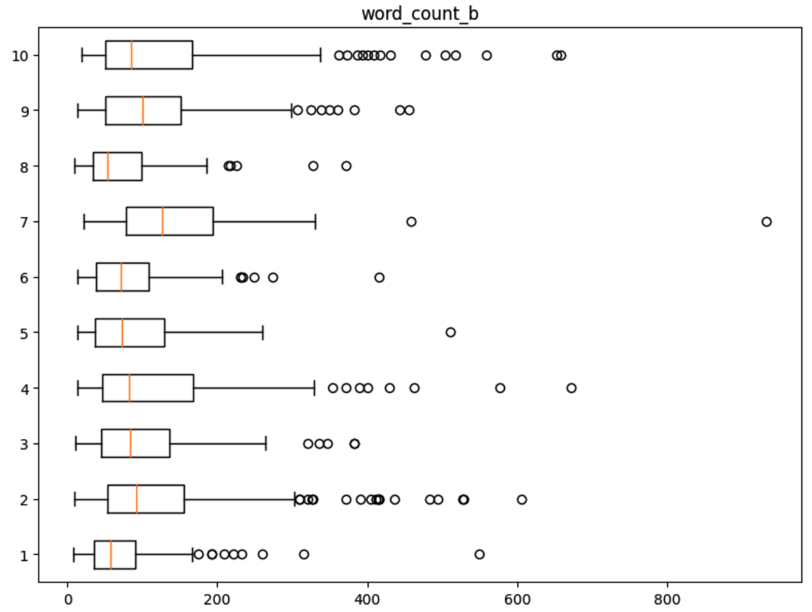
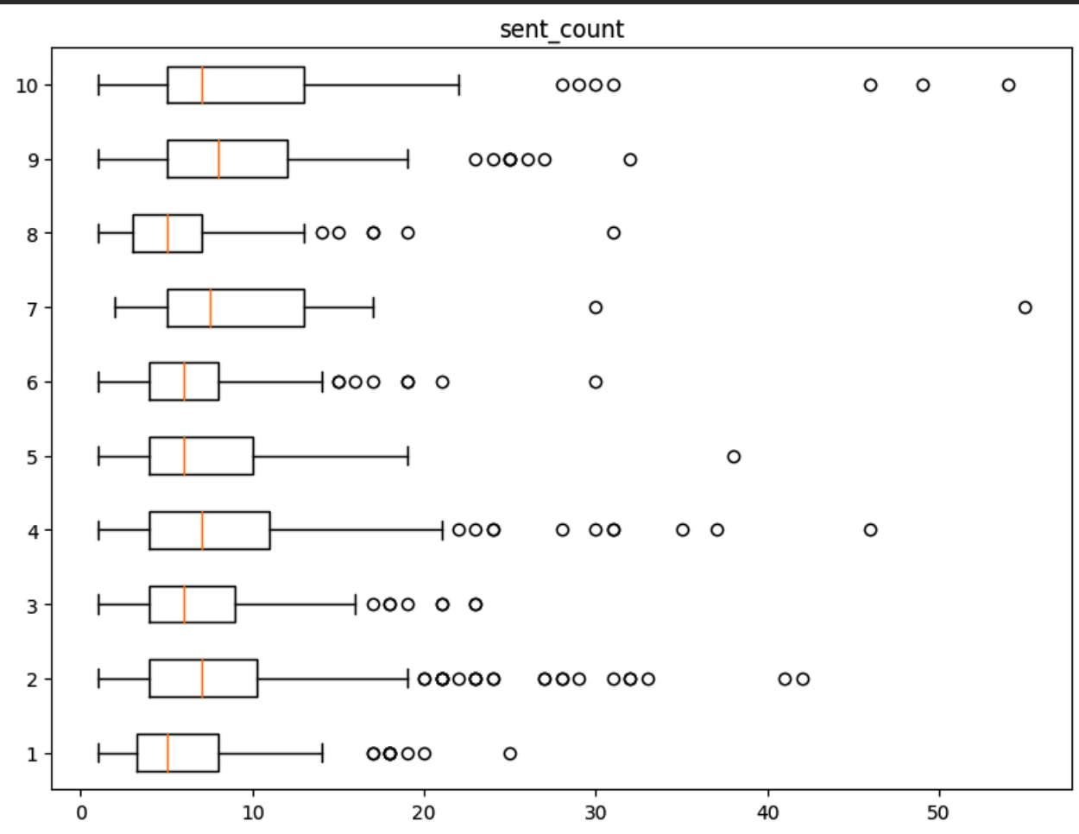
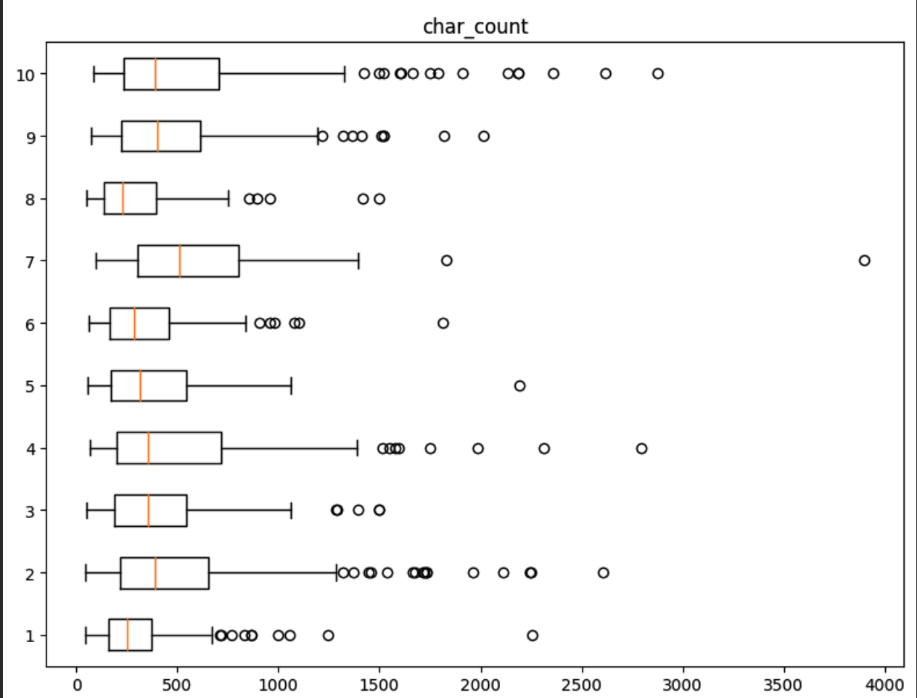
1. Box Plot – Before removing Stop words
Why Boxplot?
Box plots helped us in identifying data points that may be outliers
Depiction:
The above is the box plot which represents the sentence, word, and character counts before removing stop words.

Slide 39
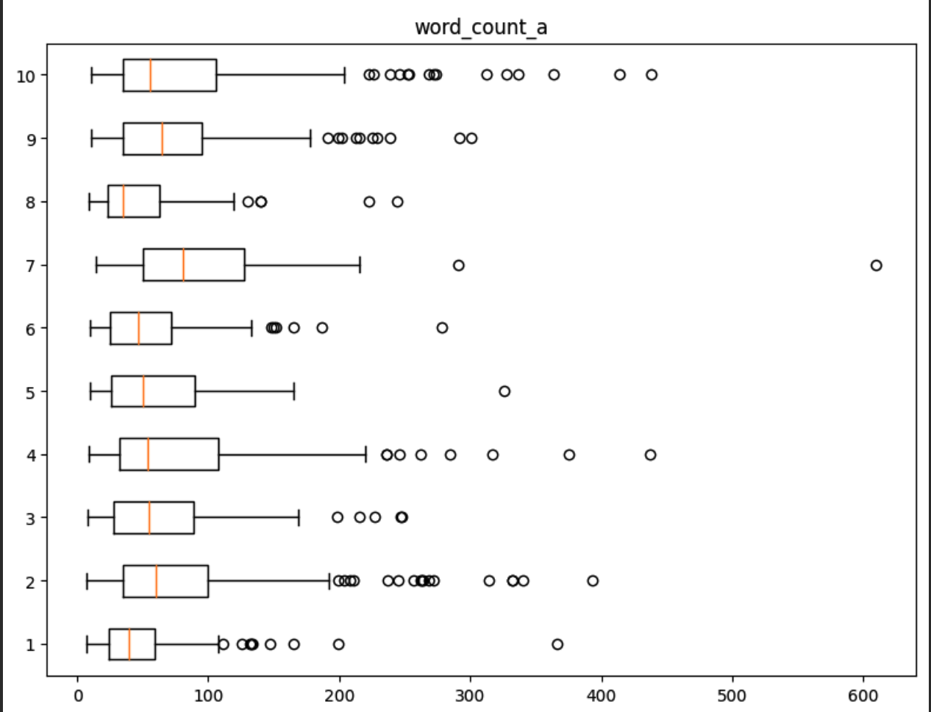
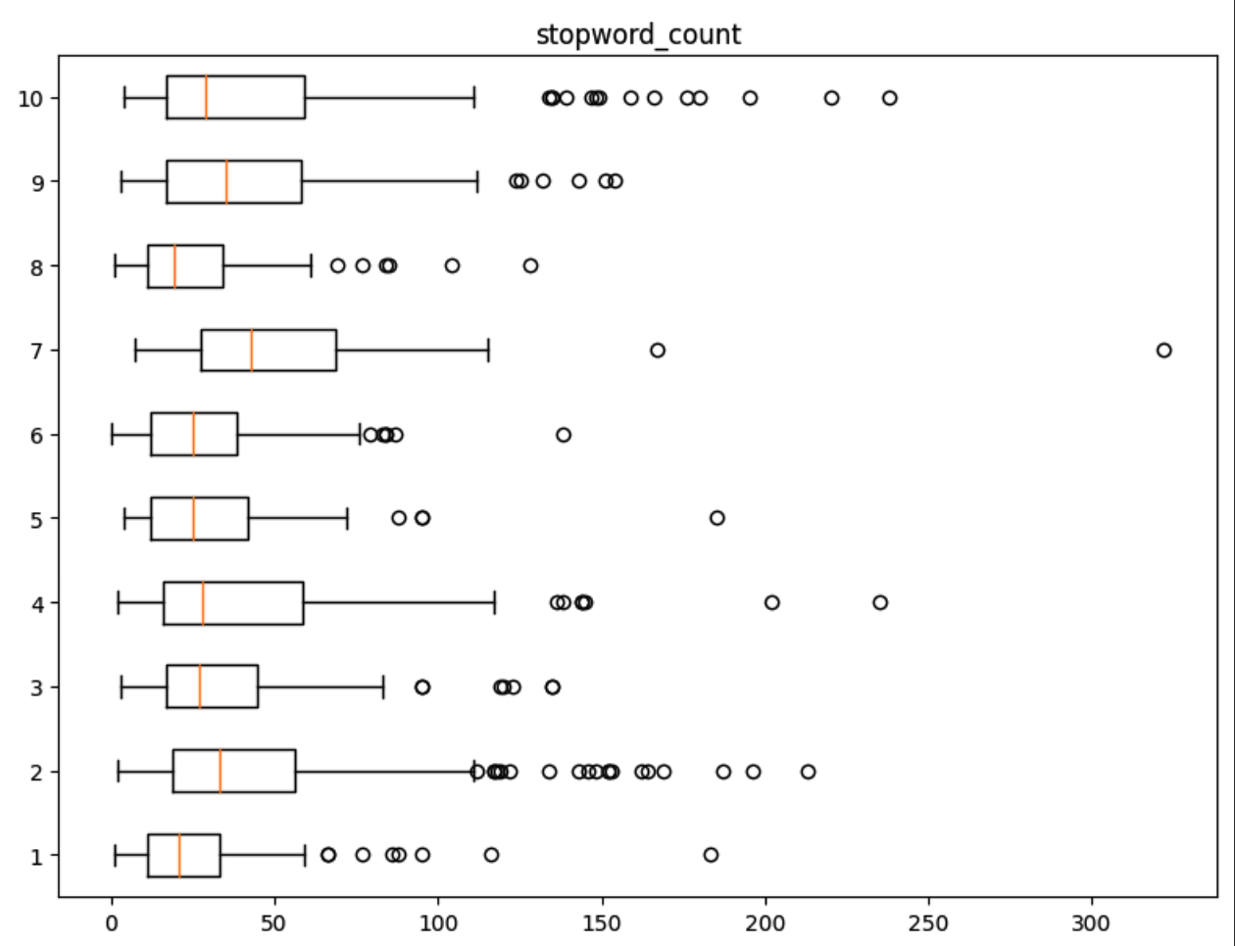
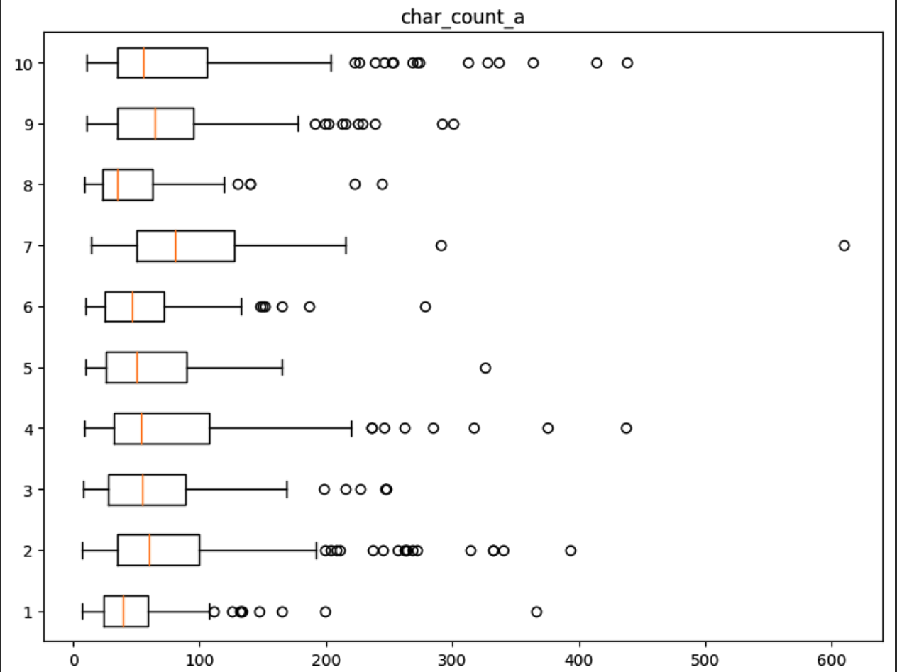
2. Box Plot – After removing Stop words
Why Boxplot?
Box plots helped us in identifying data points that may be outliers
Depiction:
The above is the box plot which represents the stop words count, word, and character counts after removing stop words.

Slide 40
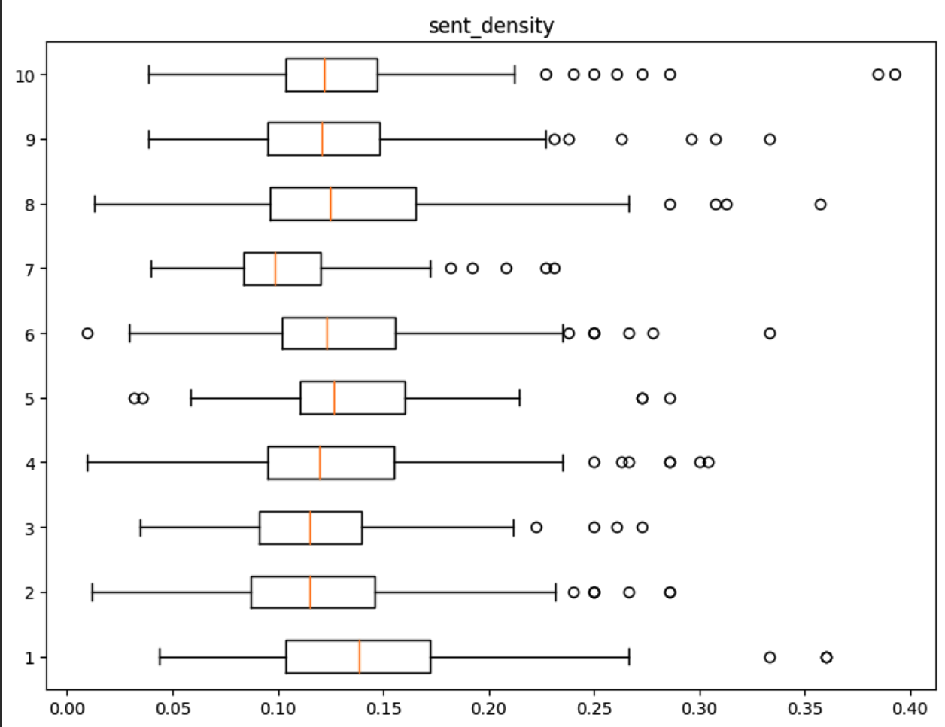
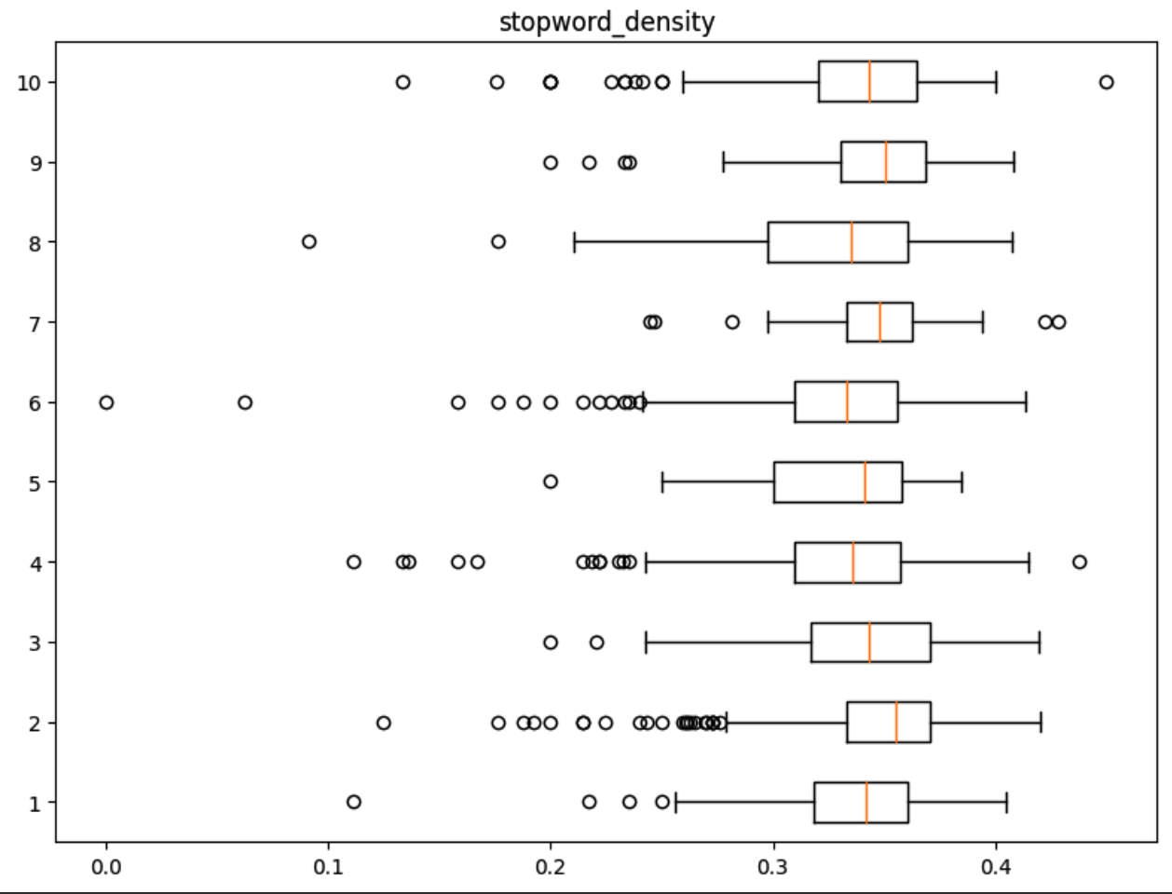
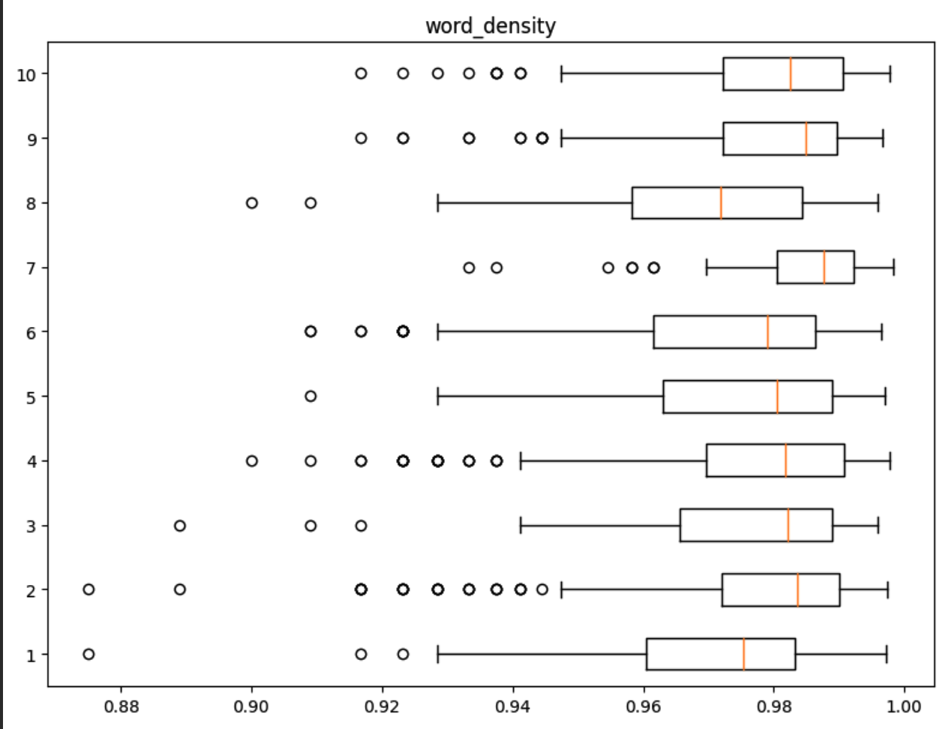
3. Box Plot – Density
Why Boxplot?
Box plots helped us in identifying data points that may be outliers
Depiction:
The above is the box plot which represents the density of stop words, words, and sentences in a review.

Slide 41
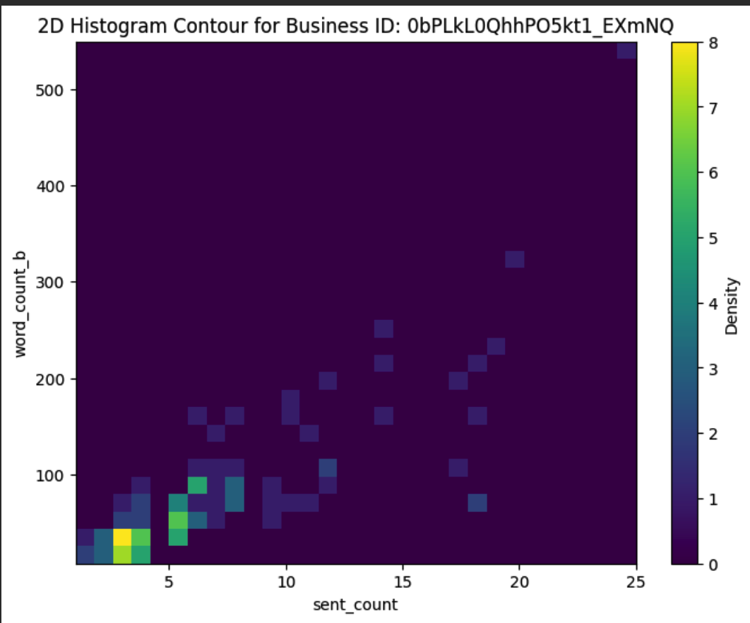
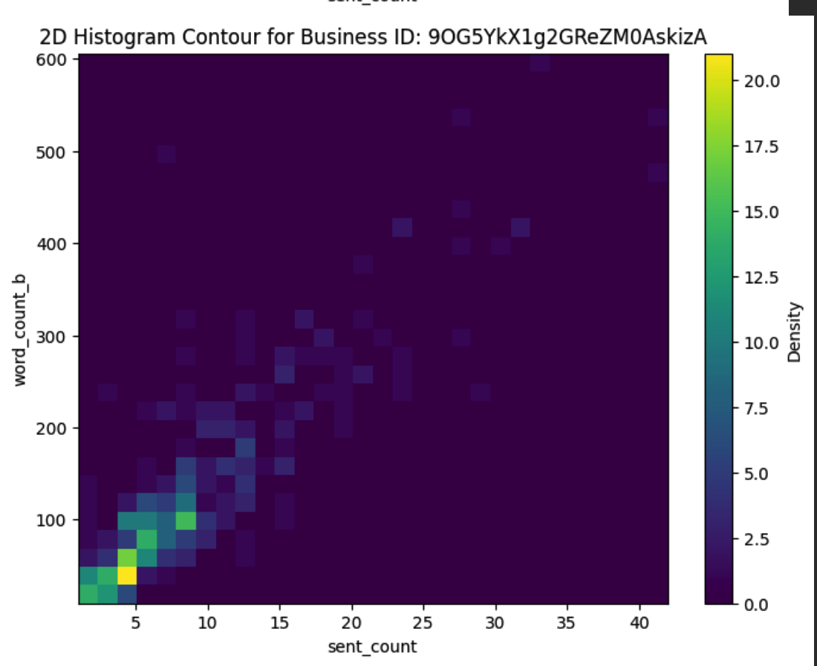
4. 2D Histogram Contour – Before removing stop words
Depiction:
The above 2D histogram contour plot represents between sentence count and word count before eliminating the stop words for each business.
This overlaps the sentence count and word count.
For example, as you can see in the first graph, says that the density is high when 2 sentences contain a word count between 20 to 30.

Slide 42
Implementation
Algorithm / Pseudocode

Slide 43

Step 1. Text summarization
Combine all the reviews of a particular business and summarize them.
Input for this summarization is combined reviews of each business, for if we have ‘n’ businesses, we will have ‘n’ reviews.
The output is a summarized text, which is a summarization of the combined reviews. The output is also ‘n’ summarized reviews.

Slide 44

Step 2. Sentiment analysis
The input of sentiment analysis is the output of text summarization.
The summarized reviews are given as input to sentiment analysis which calculates the sentiments.
The output is sentiments for each business based on the summarized reviews.

Slide 45
Implementation
Implementation Libraries

Slide 46
Data Visualization Libraries
Visualization Type | Library
Bar Graph | Matplotlib
Box Plot | Matplotlib, Seaborn
Kernal Density Estimation Plot | Seaborn
2D Historgram Contous | Plotly
Algorithm Libraries
Method | Library | Usage
Tokenization | NLTK, punkt | Used in word tokenization and sentence tokenization
Stopwords | NLTK, corpus | Used for removing stop words like ‘the’. ‘in’, etc in a text.
Text summarization | heapq, nlargest | Used when doing text summarization
Sentiment analysis | Vader Sentiment | This is used for sentiment analysis

Slide 47
Results
Performance measures and Visual diagrams

Slide 48


Sentiment Evaluation
The above code is sentiment analysis after summarization
The left code is sentiment analysis before summarization.
Both the code gives the same sentiment for the business which means the summarization is done properly.

Slide 49
Project Management

Slide 50
1. Work Completed
Completed data preprocessing tasks, including feature extraction, case conversion, elimination of non-alphabetical characters, removal of stop words, tokenization, stemming, spelling correction, and merging of data.
Implemented text summarization and sentiment analysis.
2. Responsibilities
Tasks | Person Responsible
Workflow & architecture diagram, | Kishan
Data analysis | Sijo
Data visualization | Sijo
Data preprocessing - feature extraction, case conversion, tokenization, stemming, and spelling correction | Sijo
Data preprocessing - elimination of non-alphabetical characters, removal of stop words, and merging of data. | Kishan
Algorithm implementation | Sijo, Kishan
Performance measure | Sijo, Kishan
PPT | Kishan

Slide 51
3. Contributions
Person Responsible | Percentage
Sijo Rejigeorge | 50%
Kishan Kumar Zalavadia | 50%
4. Issues/Concerns
Finding the time to collaborate has been an issue initially because of differences in everyone's schedules.
Most Text summarization libraries have python compatibility issues. Ex: Gensim

Slide 52
References/Bibliography
Class activities,
https://www.analyticsvidhya.com/blog/2020/05/what-is-tokenization-nlp/
https://www.geeksforgeeks.org/introduction-to-stemming/
https://www.topcoder.com/thrive/articles/text-summarization-in-nlp
https://monkeylearn.com/sentiment-analysis/
Project Link
GitHub Link: https://github.com/Kishan-Kumar-Zalavadia/Natural_Language_Processing

Slide 53
THANK YOU

